Slide 1
Unit-II_part 2
TREES

Slide 2
Points to be discussed…
Introduction
Tree Examples
Definitions
Related Basic Terms
Binary Tree :
  Representation using an Array
  Linked Representation of Binary Tree
  Types of Binary Tree
  General Tree

Slide 3
Linear Vs Non Linear Data Structure
Linear structure is in linear fashion
Non Linear structure is in non linear fashion

Slide 4
Trees :
Notes:
Very important type of data structure.
Need to represent data in the form of charts where the items of information are to be related by hierarchies and branches.

Slide 5
Trees Examples
Unix / Windows file structure

Slide 6
The British Constitution
Crown
Church of England
House of
Commons
House of
Lords
Supreme
Court
Cabinet
Ministers
County
Council
Metropolitan
police
Rural District
Council
County Borough Council

Slide 7
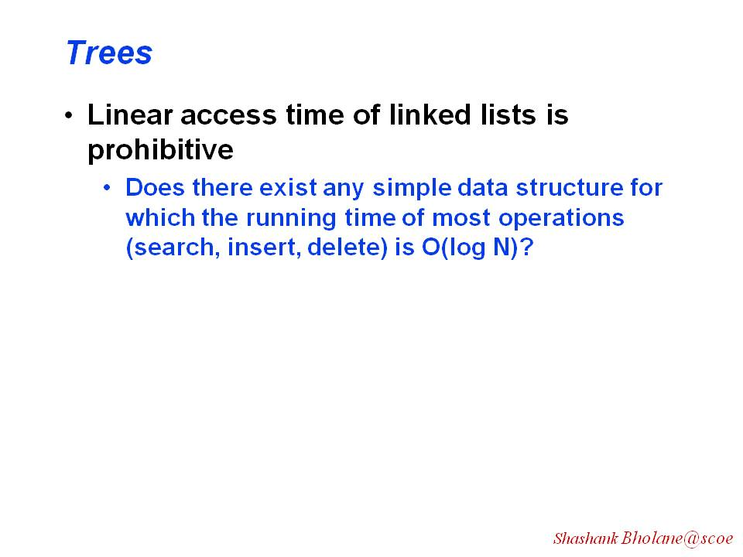

Slide 8
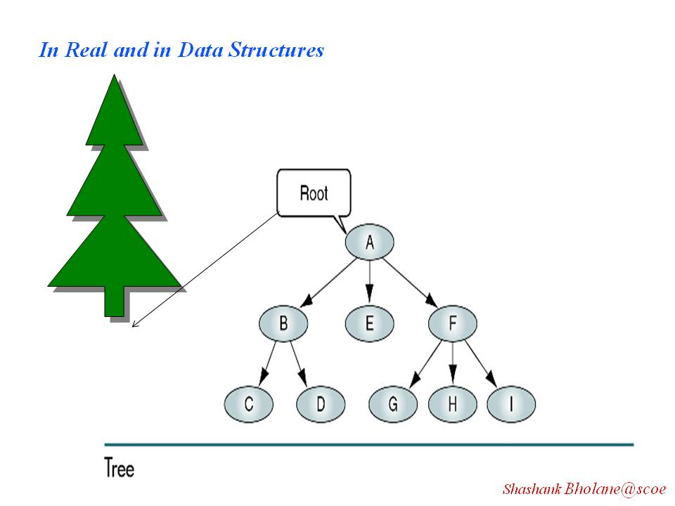

Slide 9
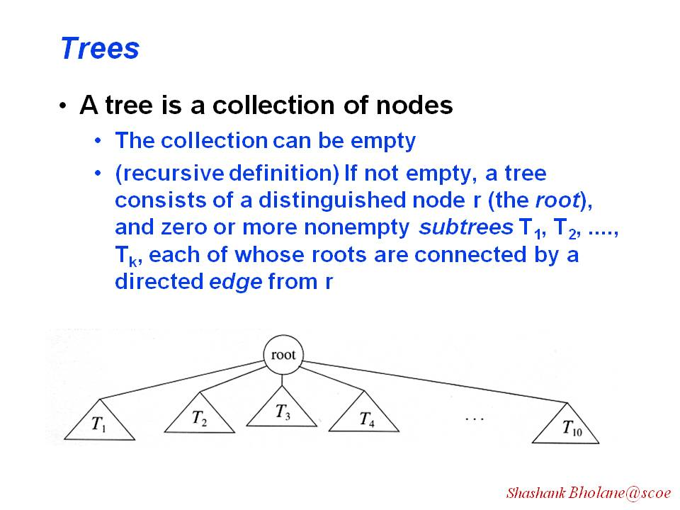

Slide 10
Definition:
A tree is a finite set of one or more elements called “nodes” such that
There is a specially designated node called the root.
The remaining nodes are partitioned into n>=0 disjoint sets T1, …..,Tn are called the sub trees of the roots which are connected by directed edge
Level
A
0
B
C
D
1
E
F
G
H
I
J
2
K
L
M
3

Slide 11
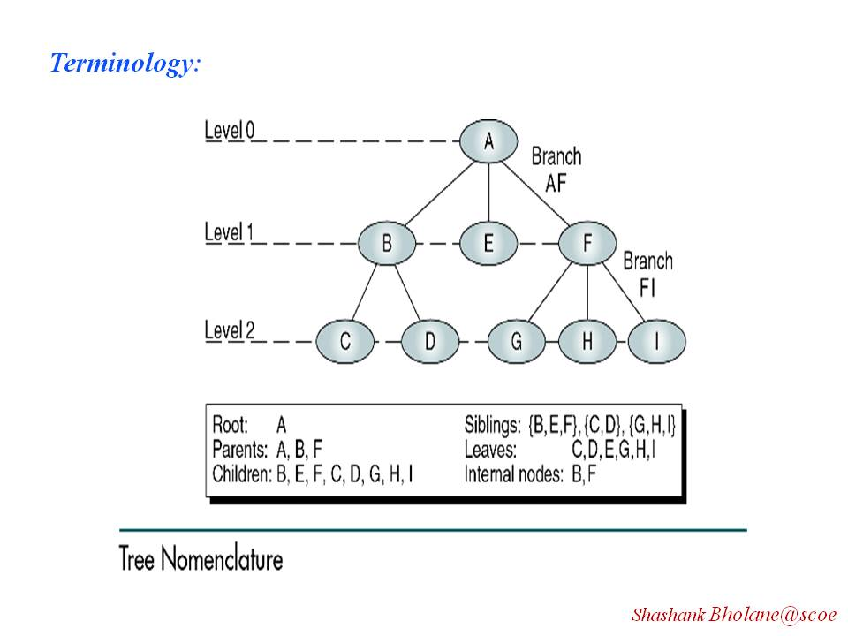

Slide 12
Terminology :
Root of the tree :
e.g. Item A is root .
Parent :
A is the parent of B,C,D
Child :
B,C,D are children of A
Siblings :
H, I ,J are siblings
Path:
Path length from D to M is - 2 as it’s connected through 2 edges.
Level
A
0
B
C
D
1
E
F
G
H
I
J
2
K
L
M
3
Notes:
Root of the tree : is the node at top most level which has no parent node and maximum m number of children .
Parent :Immediate predecessor of a node
Child : All immediate successors of a node are its children.
Siblings : Nodes with same parents are siblings.
Path:No. of successive edges from source to destination node.

Slide 13
Leaf nodes are : (terminal nodes) :
K,L,F,G,M,I,J
Degree of a node is :
A and D are nodes with
degree 3
Ancestors :
A,D are ancestors of J
Level :
“If a node is at level l its children are at level l+1”.
Height/depth of tree :
Maximum Level of the tree .
Here, it’s → 3
Level
A
0
B
C
D
1
E
F
G
H
I
J
2
K
L
M
3
Notes:
Leaf nodes are: the nodes with degree zero . (terminal nodes) e.g. K,L,F,G,I,J are the leaf node in above fig.
Degree of a node is : the number of subtrees of a node . A and D are nodes with degree 3
Ancestors : of a node are app nodes along the path from root to that node.
Level : Considering root at level 0, its children at level 1 and so on. “If a node is at level l its children are at level l+1”.
Height/depth of tree : is the maximum level number of the tree .

Slide 14
Tree Properties
Property Values
Number of nodes
Height
Root Node
Leaves
Interior nodes
Number of levels
Ancestors of H
Descendants of B
Siblings of E
Right subtree
A
B
C
D
E
F
G
H
I

Slide 15
Binary Tree :
A tree is binary if each Node of a tree can have maximum of 2 children
Example:
A is root With B as Left child
and C as right child.
A
B
B
C
D
E
F
G
H
I
J

Slide 16
Is it a binary tree?
A
B
C
D
F
E
G
H
I
J

Slide 17
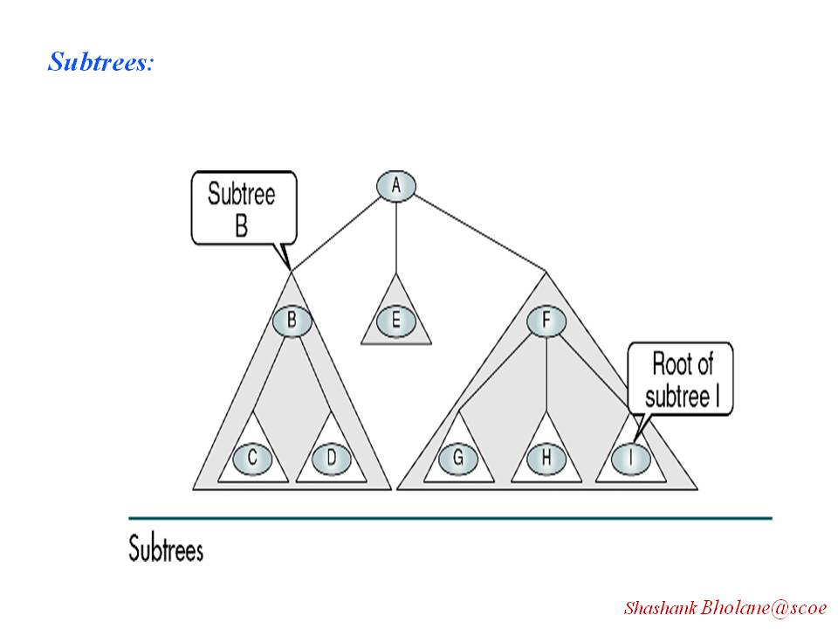

Slide 18
Representation of BT in Array
No of nodes
(existing or not existing
All nodes are from top to bottom and left to right ……
0 1 2 3 4 5 6 7
7 A B C D E F G
Index of Left child of a node i= 2 x i
Index of right child of a node i= 2 x i +1
Index of parent of a node i= i /2
A
1
2
3
B
C
4
7
5
6
D
E
F
G

Slide 19
Representation of BT in Array
0 1 2 3 4 5 6 7 8 9 10 11 12 13
13 A B C /0 G D /0
/0 /0 /0 /0 E F
A
B
C
G
D
E
F

Slide 20
Create a tree as per array:
0 1 2 3 4 5 6 7 8 9 10 11 12 13
13 A B C /0 /0 D E
/0 /0 /0 /0 /0 F

Slide 21
Binary Trees :
Special kinds of binary trees :
Complete/Full binary tree
Almost complete binary tree
Skewed binary tree – Left Skewed
-- Right Skewed
Strictly Binary Tree

Slide 22
Full Binary Tree
Maximum Number of nodes
In a binary tree of depth 4
_{k}
= Σ 2^{i-1}
^{i=1}
= 1+2+4+8
= 15
Root
A
B
C
D
E
F
G
H
I
J
K
L
M
N
O
Def^{n} : A full Binary tree of depth k is a binary tree of depth k having
2^{k+1} -1 nodes where k >=0.
A binary tree with n nodes and depth k is complete iff its
Nodes correspond to the nodes numbered from 1 to n in the full binary
Tree.

Slide 23
Almost Complete Binary Tree
A BT with depth ‘d’ is an almost complete BT if
Any node nd at level less than d-1 has son.
For any node nd in the tree with a right descendants at level d, nd must have a left son and every left descendant of nd is either a leaf at level d or has two sons.
In short,
filling should be from Top to Bottom and Left to Right
Root
A
B
C
D
E
F
G
H
I
Fig: (a )

Slide 24
Almost Complete BT??
Its satisfies only 1st condition
Root
A
B
C
D
E
F
G
H
I
J
K
Fig: (b )

Slide 25
Almost Complete BT??
It’s not satisfies any condition
Root
A
B
C
D
E
H
I
Fig: (c)

Slide 26
Strictly Binary Tree
A
root
Strictly Binary Tree has 2 x n-1 nodes
Where,
n → no. of leaves.
B
C
D
E
F
G

Slide 27
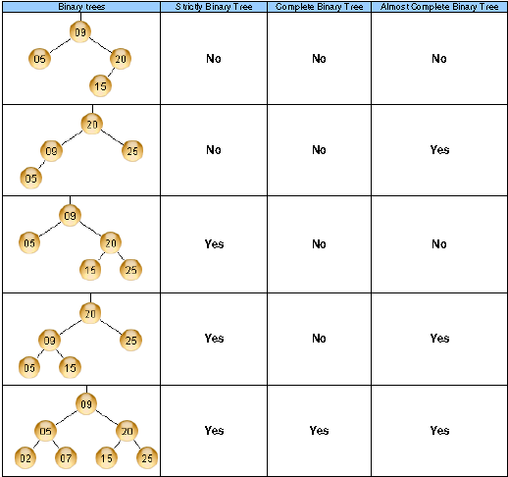

Slide 28
Skewed Binary Tree
Root
A
Root
A
B
C
D
G
H
O
Left Skewed Binary Tree
Right Skewed Binary Tree

Slide 29
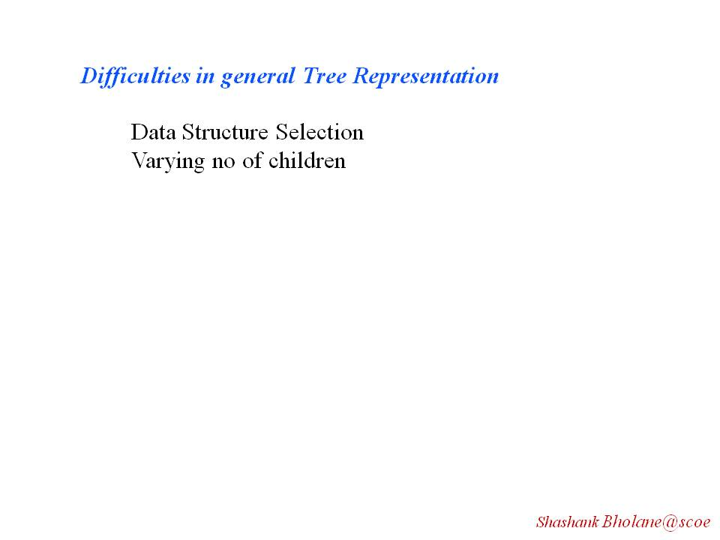

Slide 30
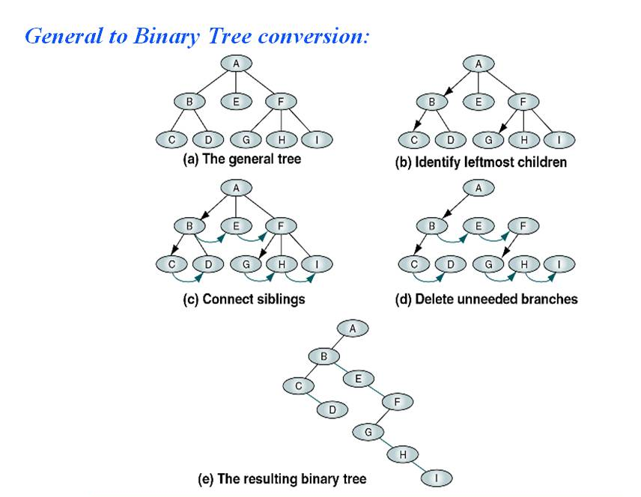

Slide 31
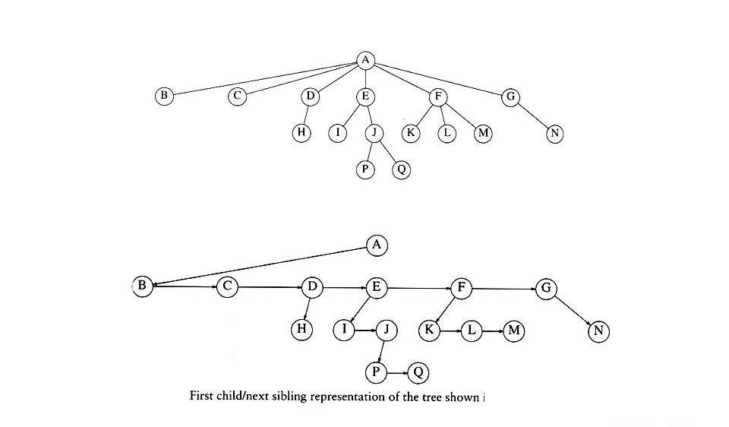
Ex: Convert General Tree to Binary Tree

Slide 32
Linked Representation of BT
class node
  {
  int data;
  node *left;
  node *right;
  };
3 Fields:
  Data
  Address of Left Child
  Address of Right Child
  Left Data Right
  /0 Data / 0
  /0 Data /0

Slide 33
class tnode
{
  friend class btree;
  int data;
  tnode *left;
  tnode *right;
public:
  tnode (int x) //parameterized constructor
  {
  data=x;
  left = NULL;
  right = NULL;
  }// back to maketree fun
};

Slide 34
class btree
{
tnode *root;
public:
  btree()
  {
  root = NULL;
  }
  void create(int n);
  void insert( int val);
  tnode *maketree(int val);
};

Slide 35
tnode *btree :: maketree (int val);
{
tnode *node;
node =new tnode(val);
return(node);
// Left node
// Right node
}

Slide 36
void btree :: create(int n)
{
int i=0; val;
while (i<n)
{
cout<< “Give value to insert:”;
cin>> val;
insert(val);
i++;
}
}

Slide 38
void btree :: insert(int val)
{
tnode *temp, char direction;
int insert = 0;
  if (root==NULL)
  {
  root = maketree(val);
  insert=1;
  }
else
{
temp = root;
do
{
cout<< “where to insert left/right of ”
<<temp->data<< “:”;
cin>>direction;

Slide 39
if (direction== ‘l’)
{
if (temp->left != NULL)
temp = temp->left;
else
{
temp->left= maketree(val);
insert=1;
}
}

Slide 40
else if (direction== ‘r’)
{
if (temp ->right !=NULL)
temp= temp->right;
  else
  {
  temp->right= maketree(val);
  insert=1;
  }
}
while(insert==0);
}
}// btree insert end

Slide 41
main()
{
btree bt;
case 1: cout<< “ how many nodes in BT:”;
cin>>n;
bt.create(n);
break;
case 2: cout<< “ Give any elements to insert:”;
cin>>val;
bt.insert(val);
break;
}

Slide 42
Binary Tree traversal
Traversing – “Visiting each and every tree node exactly once”.
In order Traversals
Preorder Traversals
Post order Traversals
Notes:
Most of the tree operations are based on the traversing method used.
A full traversal of the tree produces a linear order of the nodes.
Hence it is possible to access the tree and process the information built in it in a specific order.
There are three operations on which the traversals are based.
L- Moving to left.
V- Visiting the current node.
R- Moving to right.
Using these notations there are six possible combinations and three
Traversals .
Inorder – LVR, RVL
Postorder- LRV, RLV
Preorder- VLR, VRL

Slide 43
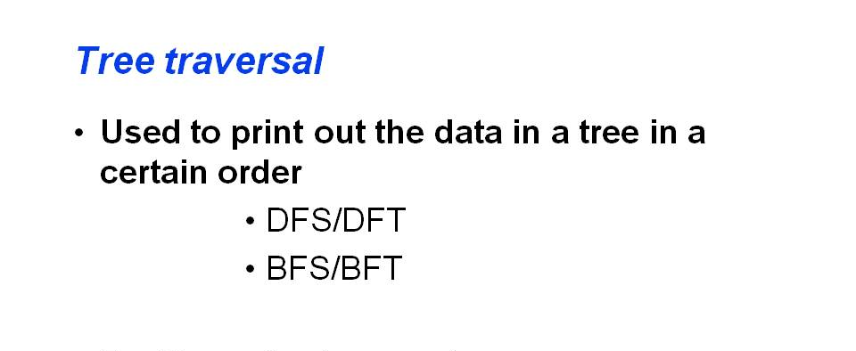

Slide 44
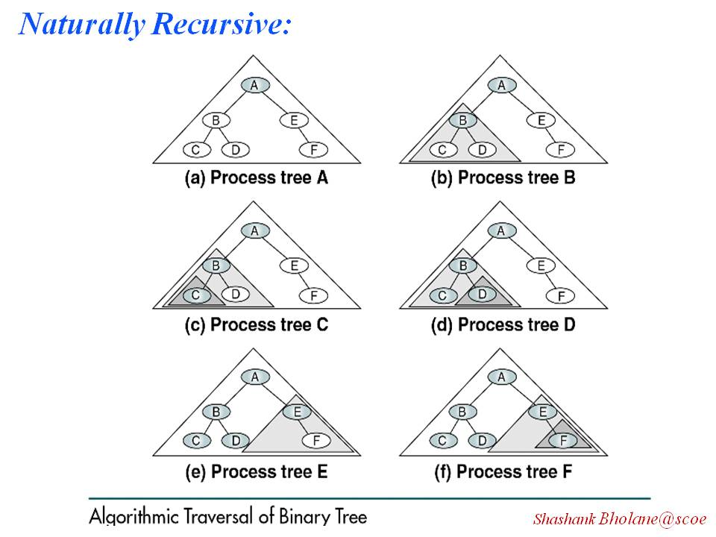

Slide 45
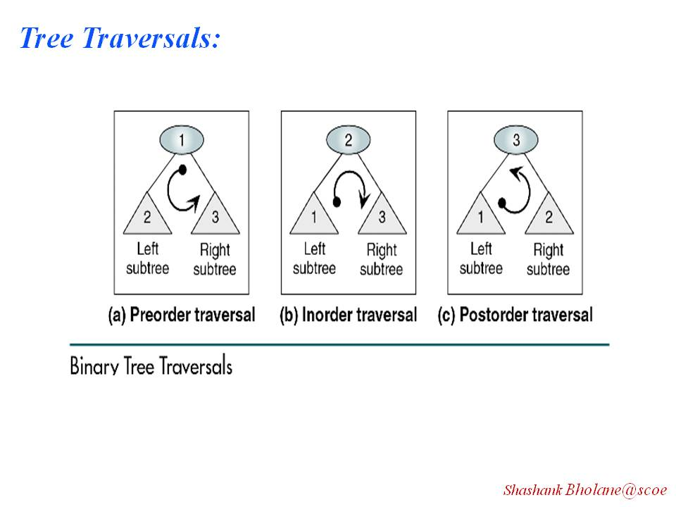

Slide 46
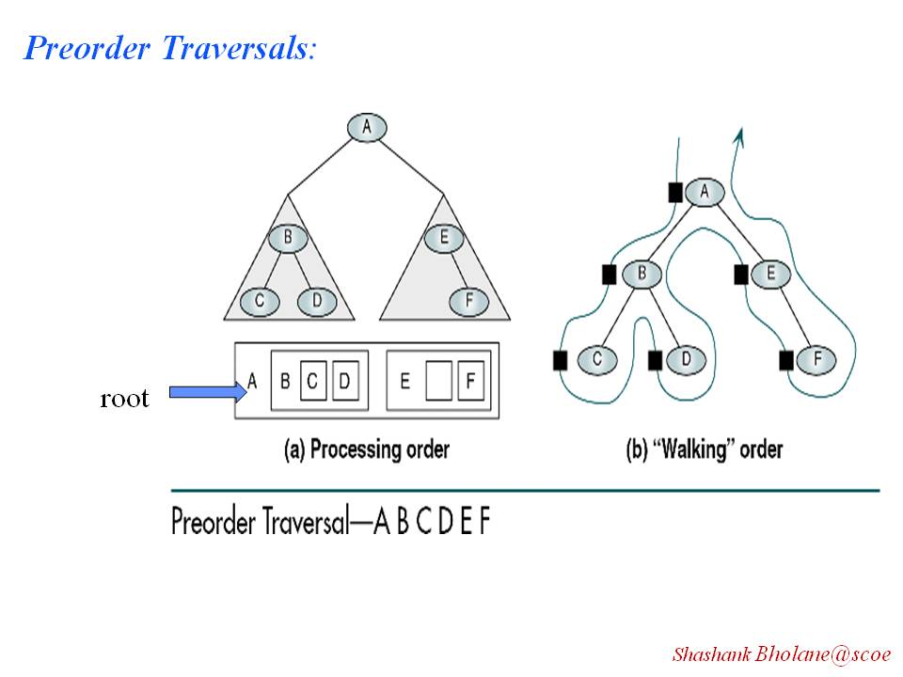

Slide 47
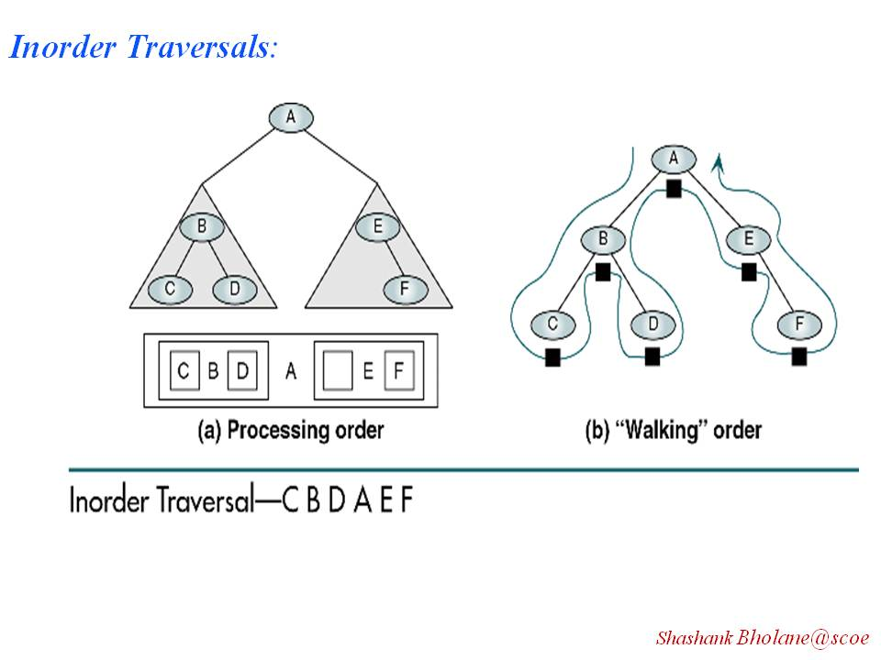

Slide 48
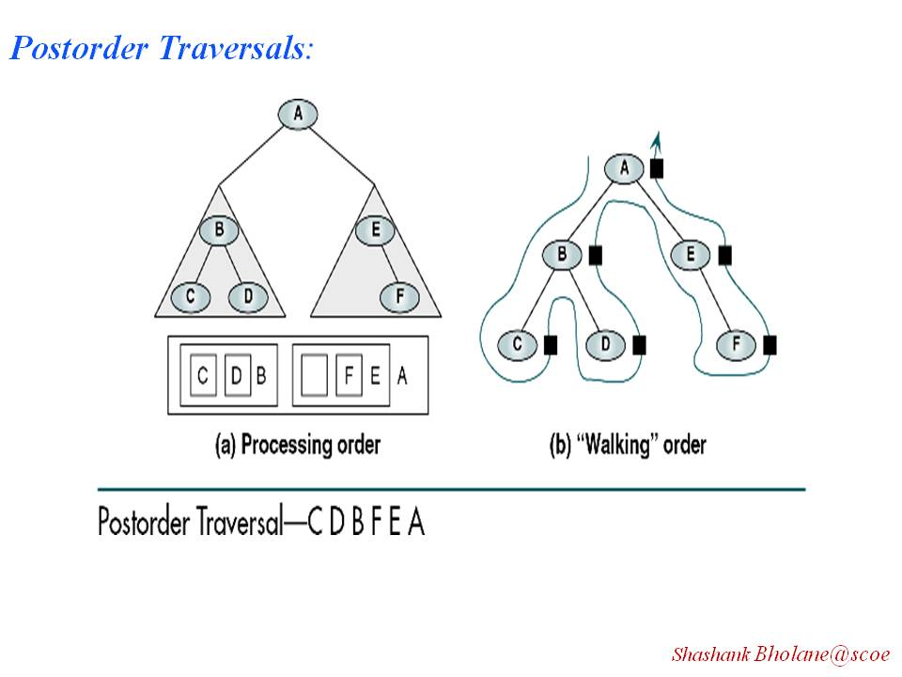

Slide 49
Preorder Traversal-/(Prefix walk)/DLR() sequence
1 Visit the current /root and retrieve, process the element.
2 Move left and traverse the left sub-tree by “Pre-order”.
3 Move to right and traverse the right sub-tree by “Pre-order”.
  void Tree :: preorder( )
  {
  preorder(root);
  }
  void Tree::preorder( tnode *temp)
  {
    if (temp!=NULL)
    {
    cout << temp-> data;
    preorder(temp -> Left);
    preorder(temp-> Right);
    }
  }
Calling function from main

Slide 50
In-orderTraversal/ Infix Traversal/LDR ()
  1 Move left and traverse the left subtree by “Inorder”.
  2 Visit the current /root and retrieve, process the element.
  3 Move to right and traverse the right subtree by “Inorder”.
  void Tree :: inorder( )
  {
  inorder(root);
  }
  void Tree::inorder( tnode* temp)
  {
    if (temp!=NULL)
    {
    inorder(temp -> left);
    cout << temp -> data;
    inorder(temp -> right);
    }
  }
Calling function from main

Slide 51
Post-order Traversal/ Postfix Traversal/LRD ()
  1 Move left and traverse the left subtree by “Inorder”.
  2 Visit the current /root and retrieve, process the element.
  3 Move to right and traverse the right subtree by “Inorder”.
  void Tree :: postorder( )
  {
  postorder(root);
  }
  void Tree::postorder( tnode* temp)
  {
    if (temp!=NULL)
    {
    postorder(temp -> left);
    postorder(temp -> right);
    cout << temp -> data;
    }
  }
Calling function from main

Slide 52
Non-Recursive Preorder Traversal
void preorder(node *root)
{
push(root);
while(stack not empty)
{
temp=pop();
if (temp!=NULL)
{
cout<<temp->data;
push(temp->right);
push(temp->left);
}//if ends
}//while end
}//fun end

Slide 53
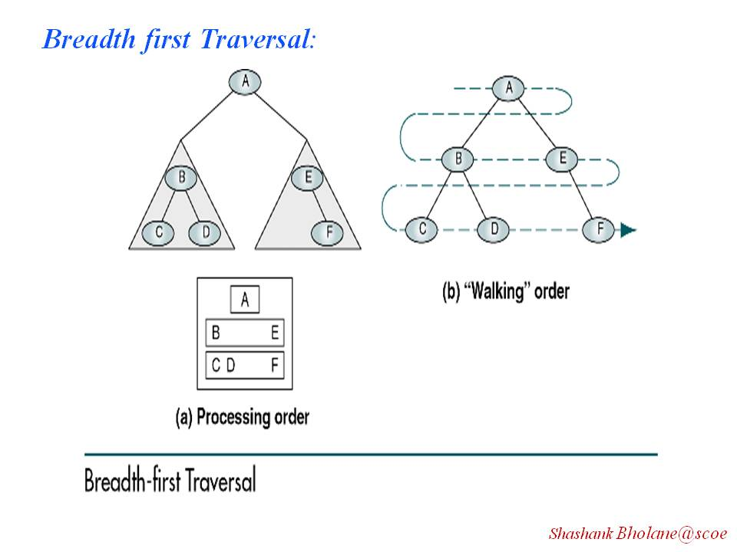

Slide 54
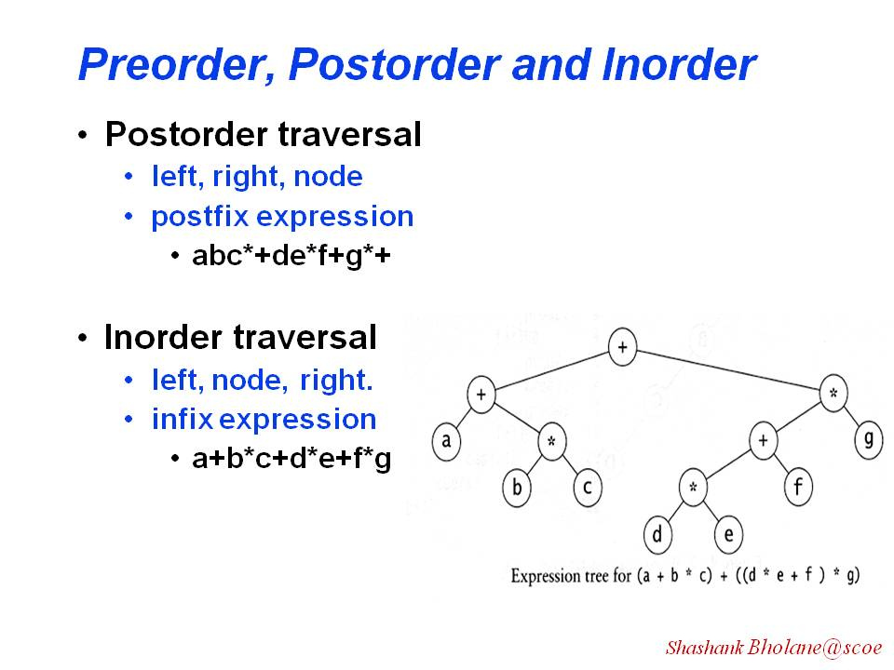

Slide 55
Applications of binary tree:
1] Arithmetic Expression tree
Nodes represent tokens either operand or operator.
All operands as leaf nodes
All operators as parent of its left and right expression. Here expression represent the left and right subtrees respectively.
Operators are stored an such manner that
Operators with higher priority hold higher level node.
The root node holds the operator with lowest priority.
expr1 = (a+b) * (c-d) expr2=a+b*c-d/2
Root
-
root
*
+
/
+
-
a
*
d
2
a
c
d
b
b
c

Slide 56
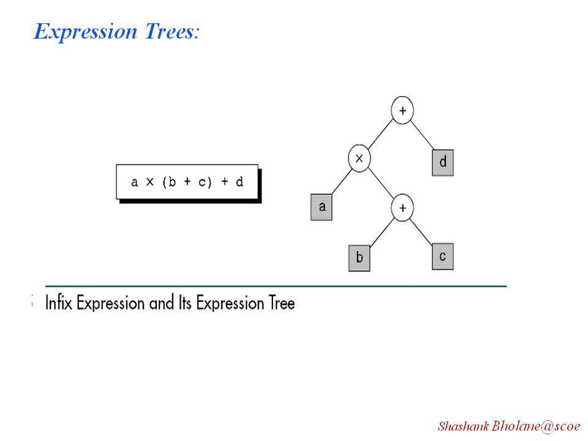
Infix expression

Slide 57
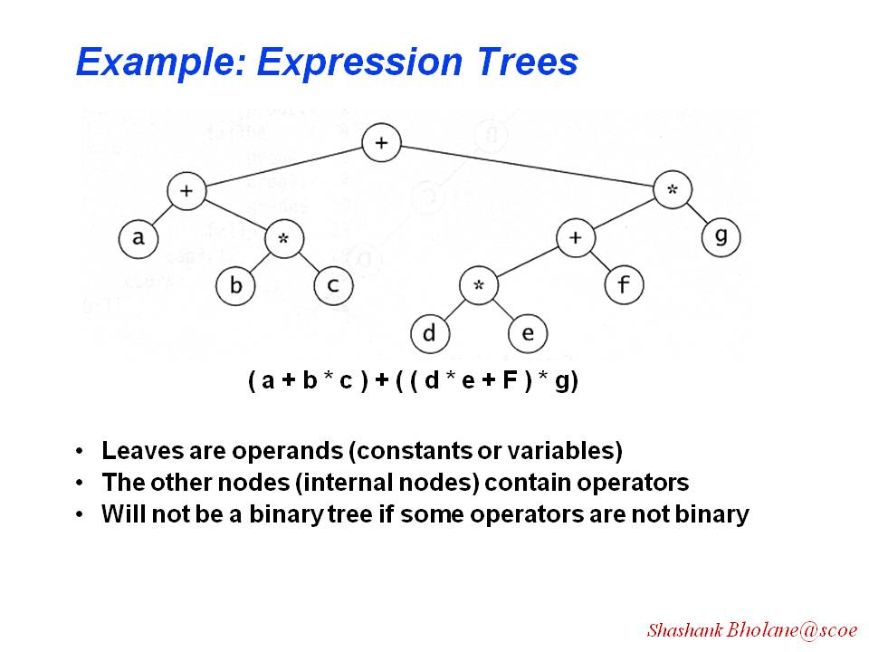

Slide 58
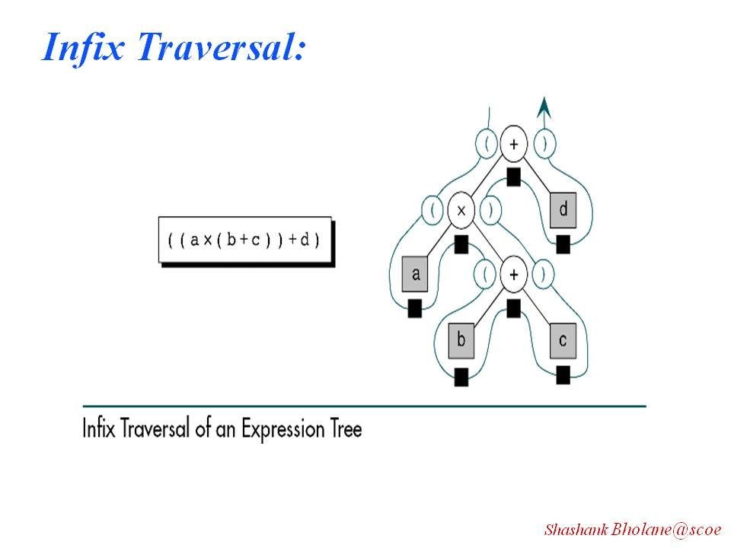

Slide 59
2 ]Binary Search Tree :
This is another application. The binary tree is further ruled by the
additional property that makes it a search tree.
All elements in bst are stored in such a manner that
Left subtree holds values less than root element value.
Right subtree holds values greater than root element.
And left and right subtrees are recursively Binary Search Tree
70
bst
50
92
32
60
78
97
20
45
55
68
75
80
94
99

Slide 60
Create BST for following
e.g. 1. 10 , 5, 3, 14, 12, 16, 7, 6, 15
e.g. 2. q , s, d, a, f, r, t
e.g. 3. Jan, Feb, Apr, Mar, May
e.g. 4. sad=not happy, cry= scream, yell=shout

Slide 61
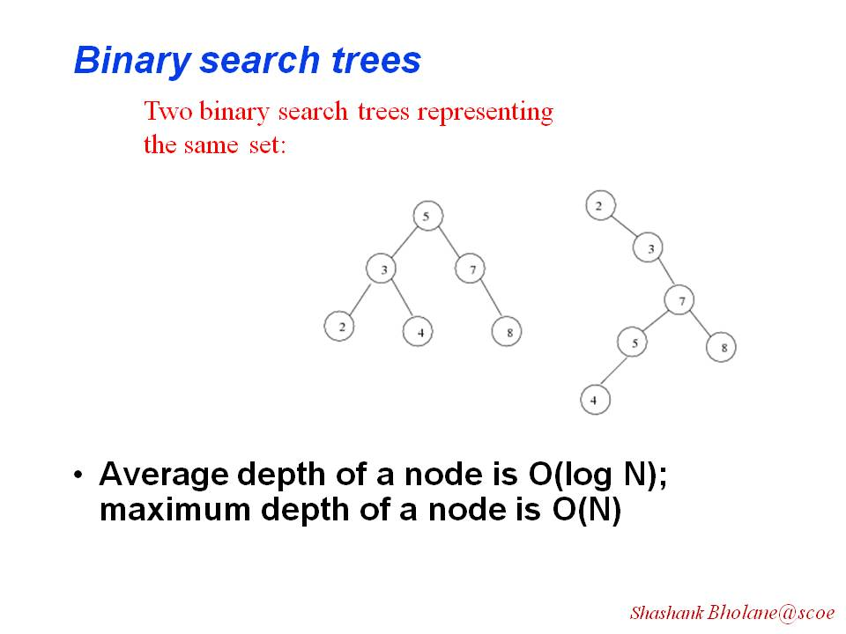

Slide 62
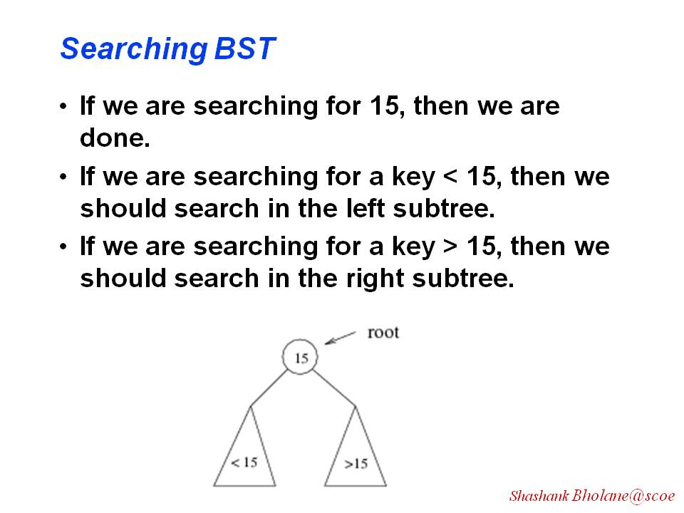

Slide 63
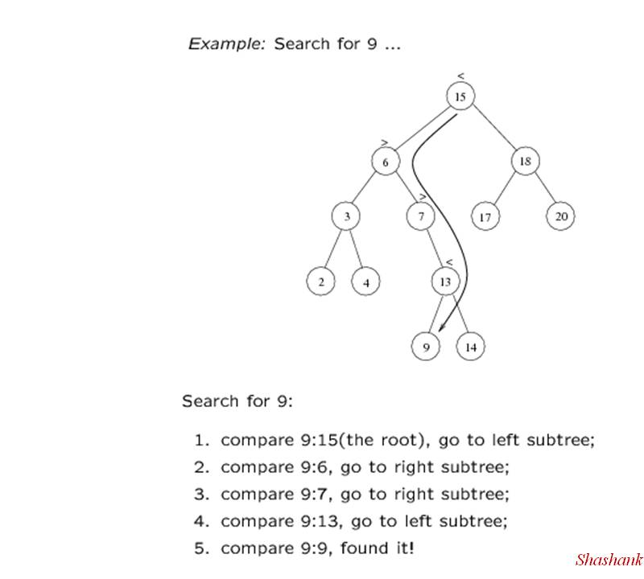

Slide 64
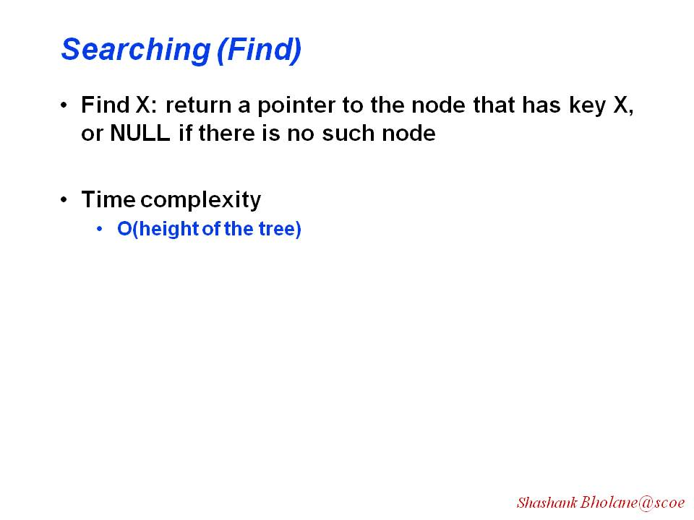

Slide 65
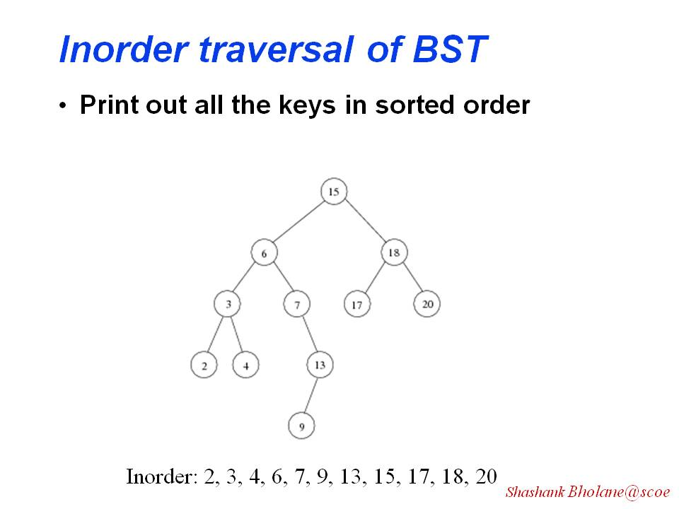

Slide 66
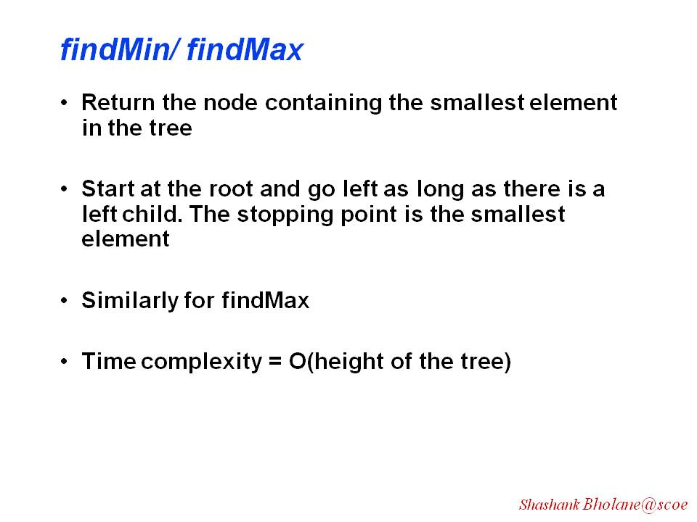

Slide 67
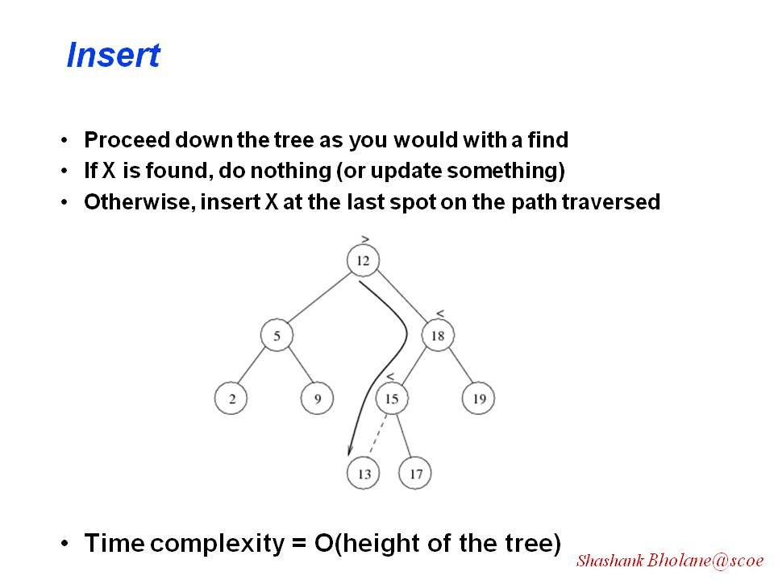

Slide 68
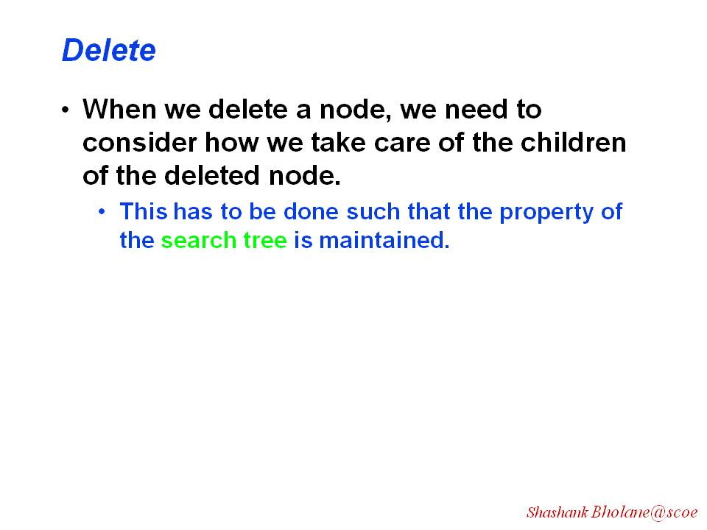

Slide 69
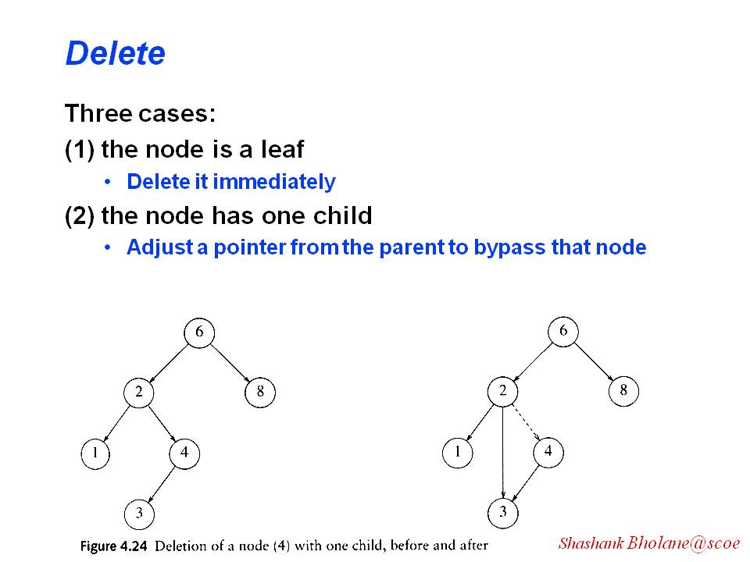

Slide 70
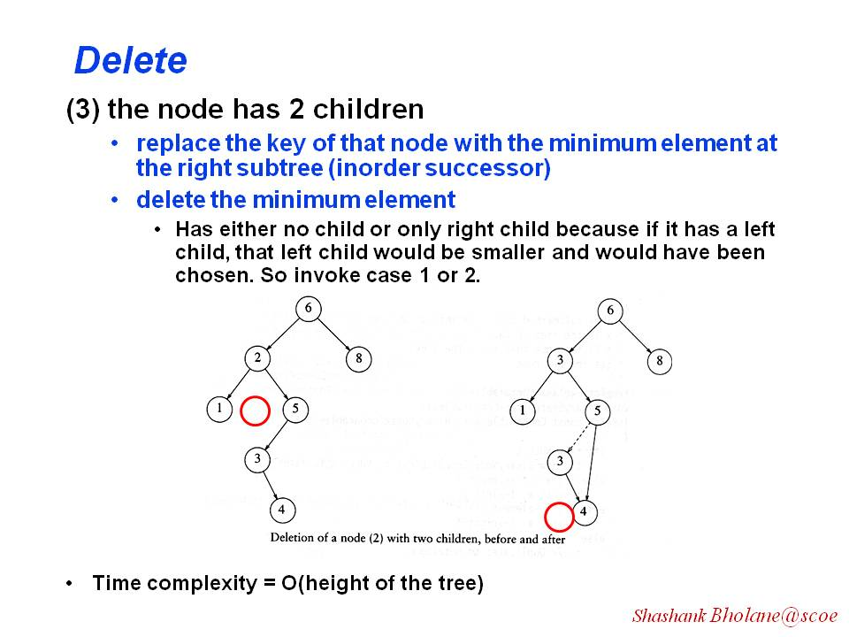

Slide 71
class bstnode
{
  friend class bstree;
  int data;
  tnode *left;
  tnode *right;
public:
  tnode (int x) //parameterized constructor
  {
  data=x;
  left = NULL;
  right = NULL;
  }// back to maketree fun
};

Slide 72
class bstree
{
bstnode *root;
public:
  bstree()
  {
  root = NULL;
  }
  void create(int n);
  void insert( int val);
  tnode *maketree(int val);
};

Slide 73
bstnode * bstree :: maketree (int val);
{
bstnode *node;
node =new bstnode(val);
return(node);
// Left node
// Right node
}

Slide 74
void bstree :: create(int n)
{
int i=0; val;
while (i<n)
{
cout<< “Give value to insert:”;
cin>> val;
insert(val);
i++;
}
}

Slide 75
void bstree :: insert(int val)
{
bstnode *temp;
int insert = 0;
  if (root==NULL)
  {
  root = maketree(val);
  insert=1;
  }
else
{
temp = root;
do
{

Slide 76
if (temp->data>val)
{
if (temp->left != NULL)
temp = temp->left;
else
{
temp->left= maketree(val);
insert=1;
  cout<<data is inserted as left child of <<temp->data;
}
}

Slide 77
else if (temp->data < val)
{
if (temp ->right !=NULL)
temp= temp->right;
  else
  {
  temp->right= maketree(val);
  cout<<data is inserted as right child of <<temp->data;
  insert=1;
  }
}
while(insert==0);
}
}// btree insert end

Slide 78
main()
{
bstree bt;
case 1: cout<< “ how many nodes in BT:”;
cin>>n;
bt.create(n);
break;
case 2: cout<< “ Give any elements to insert:”;
cin>>val;
bt.insert(val);
break;
}

Slide 79
Operations on BST
Searching a key
Find Minimum number
Find Maximum number
Delete a node
Ascending order
Descending order

Slide 80
Find the Target Key in BST
int find (tnode * root, int targetkey)
{
int flag = 0, tnode * temp = root;
while (temp ! = NULL)
{
  if (targetkey == temp->data)
  {
  cont <<targetkey << “is found in BST”;
  flag=1;
  break;
  }

Slide 81
if (targetkey > temp -> data)
{
temp = temp ->right;
}
else
{
temp = temp -> left;
}
} // end while
return (flag);
}

Slide 82
Main ( )
{
int targetkey, flag;
case 1: cout << “enter targetkey”;
cin >> targetkey;
flag = find (root, targetkey);
if (flag = = 1)
cout << “key found”;
}

Slide 83
Find Max
int BSTtree::findMax(node *root)
{
node *temp=root;
if(root!=NULL)
{
while (temp->right!=NULL)
temp= temp->right;
}
return (temp->data);
}

Slide 84
Find Min
int BSTtree::findMin(node *root)
{
node *temp=root;
if(root!=NULL)
{
while (temp->left!=NULL)
temp= temp->left;
}
return (temp->data);
}

Slide 85
Deletion of Node -3 cases
Leaf Node Deletion
Deletion of a node with either child. (a. Left child or b. right child)
Deletion of a node with 2 children

Slide 86
Deletion of Node -1st case
if (temp->left == NULL && temp->right== NULL)
{ if(parent->left==temp)
{
        parent->left=NULL;
        delete(temp);
        temp=NULL;
    }
    else
    {
    parent->right=NULL;
        delete(temp);
        temp=NULL;
    } return;
    } // end of case 1;

Slide 87
Deletion of Node -2nd case (with left child)
if (temp->left != NULL && temp->right== NULL)
{ if(temp==root)
root=NULL;
else if(parent->left==temp)
{
        parent->left=temp->left;
        }
    else
    {
    parent->right=temp->left;
    }
    delete(temp);
    temp=NULL; return;
    } // end of case 1;

Slide 88
Deletion of Node -2nd case (with right child)
if (temp->left== NULL && temp->right!= NULL)
{
if(temp==root)
root=NULL;
elseif(parent->left==temp)
{
        parent->left=temp->right;
        }
    else
    { parent->right=temp->right;}
    delete(temp);
    temp=NULL; return;
    } // end of case 1;

Slide 89
Deletion of Node 3rd case(with both children)
elseif (temp->left!= NULL && temp->right!= NULL)
{
parent =temp;
temp_succ =temp->right;
while (temp_succ-> left!=NULL)
{
        parent=temp_succ;
        temp_succ=temp_succ->left;
        }
    temp->data=temp_succ->data;
    delete(temp->right,temp,temp_succ->data);
    return;
    } // end of case 3;

Slide 90
Deletion Function (write all 3 cases inside)
Void del(bstnode *root , bstnode *parent,int key)
{
bst *temp_succ,*temp;
    temp=root;
    if (root ==NULL)
    cout<<“tree nt exist”;

Slide 91
else //search key
{
while (temp!=NULL)
{
if (key==temp->data)
{
cout<<“key found”;
break;
else if (key>temp->data)
{
parent=temp;
temp= temp->right;
}

Slide 92
else
{
parent=temp;
temp= temp->left
}
}
//All 3 Cases:
    } // end del

Slide 93
BST Operation Performance
BST Cases | Search | Insert | Delete
Average case | O(log n) | O(log n) | O(log n)
Best case | O(h) | O(h) | O(h)
Worst case | O(n) | O(n) | O(n)

Slide 94
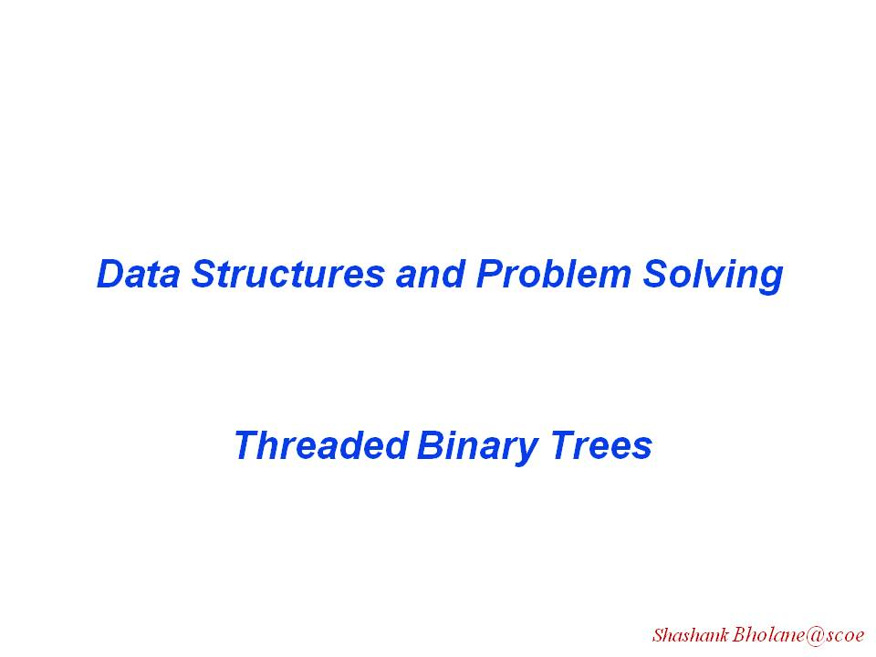

Slide 95
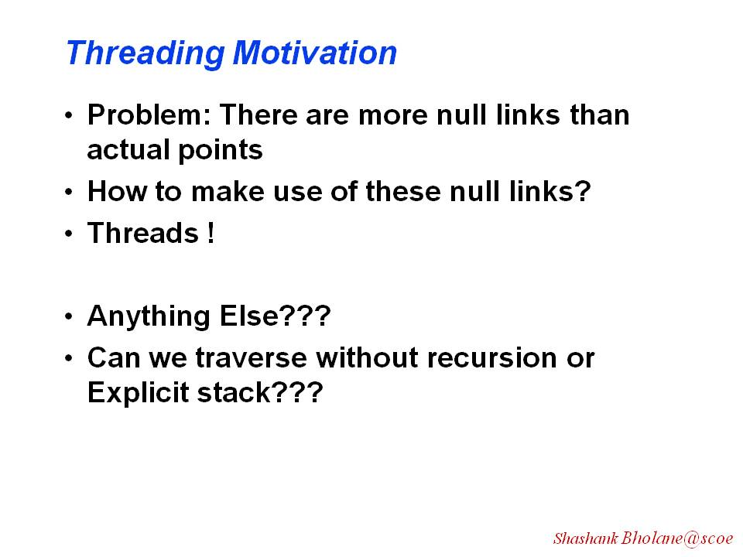

Slide 96
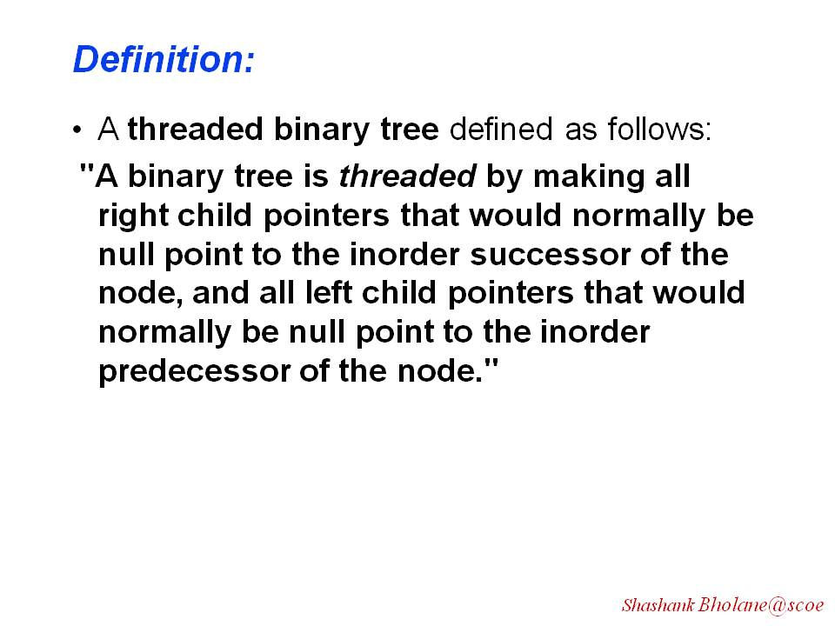

Slide 97
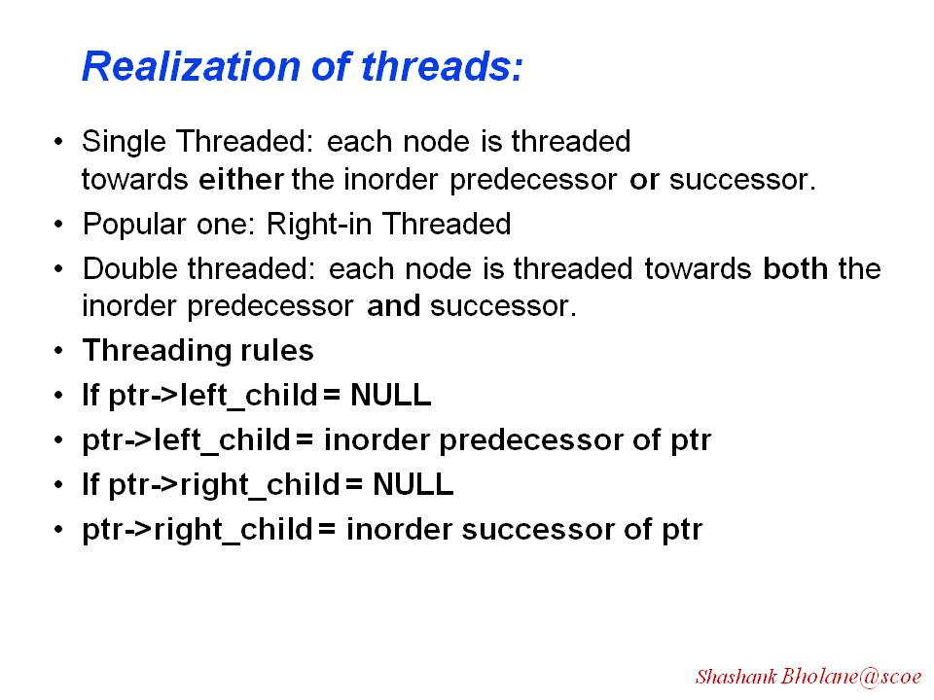

Slide 98
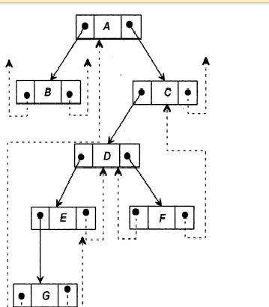
Threaded Binary tree:
Dummy Node
Root

Slide 99
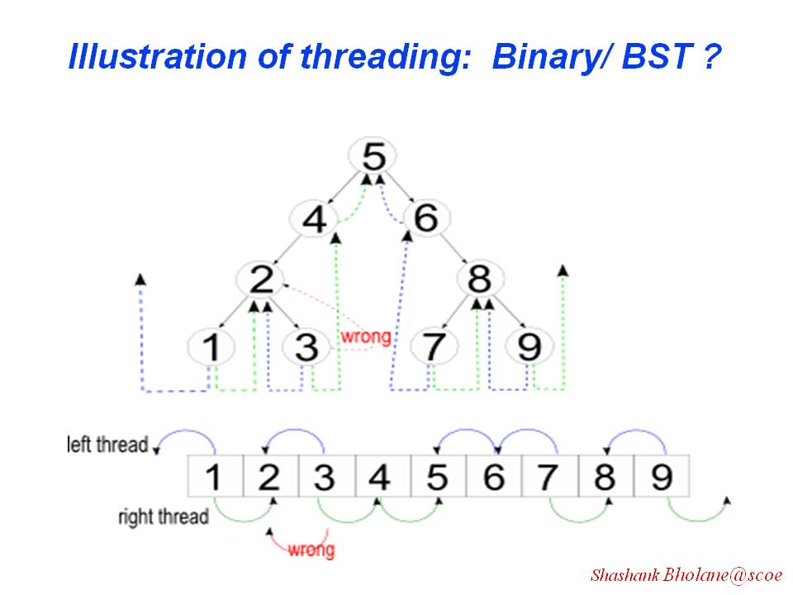

Slide 100
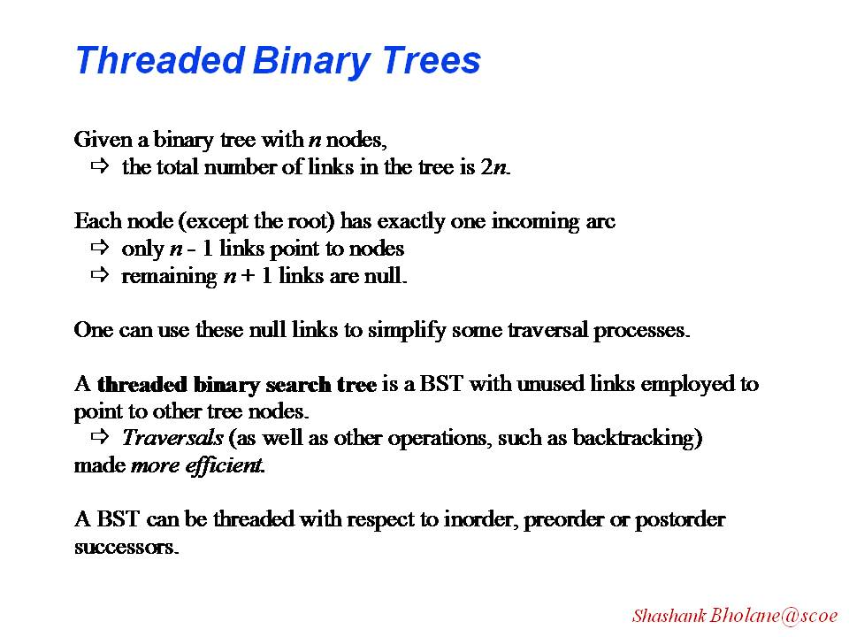

Slide 101
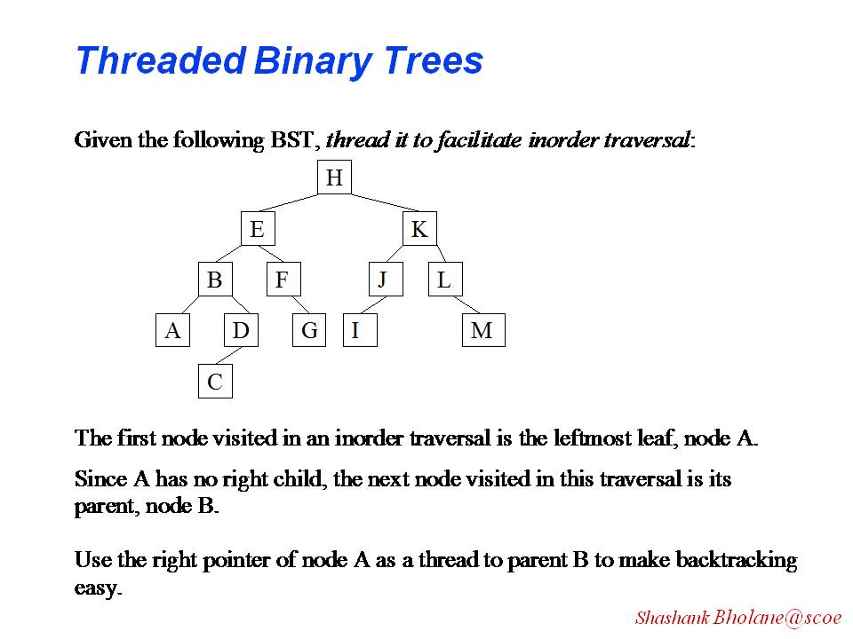

Slide 102
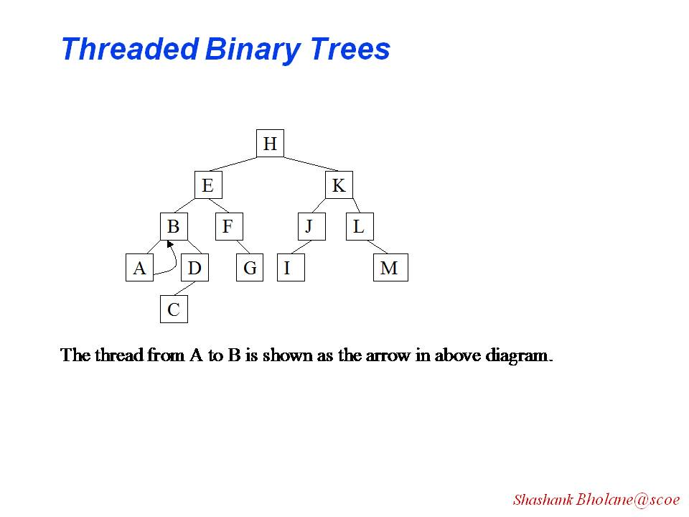

Slide 103
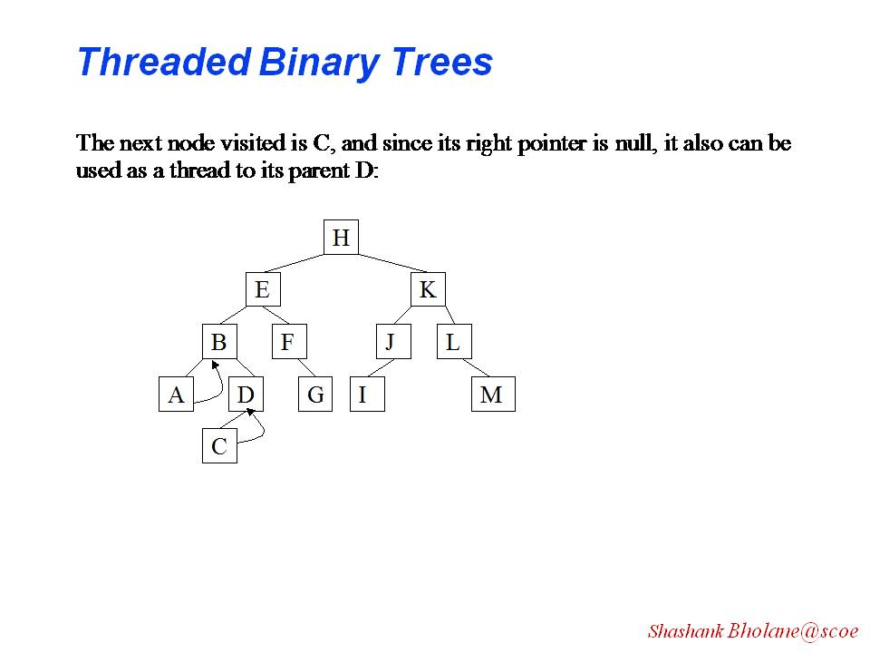

Slide 104
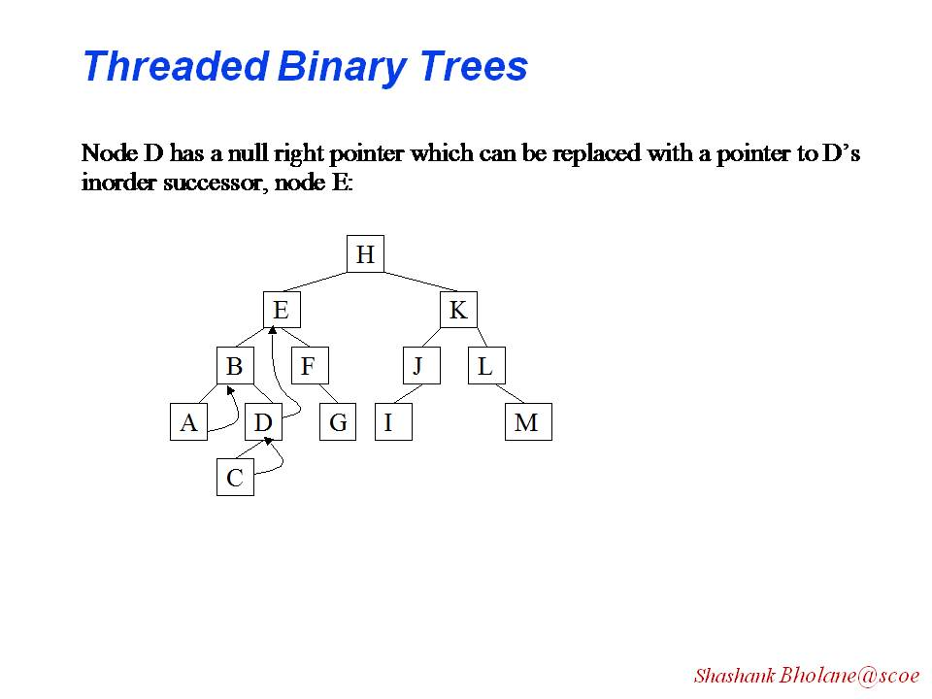

Slide 105
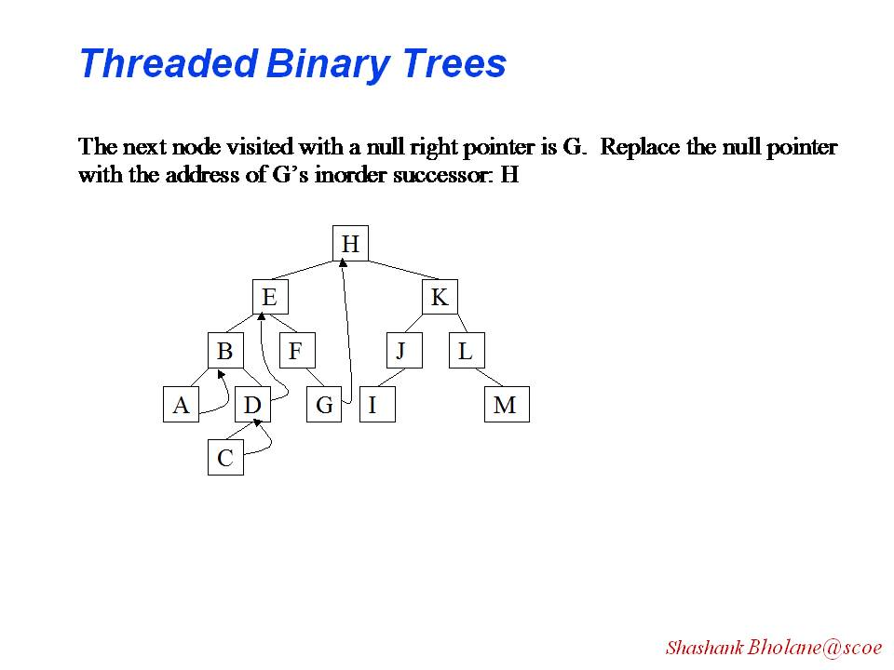

Slide 106
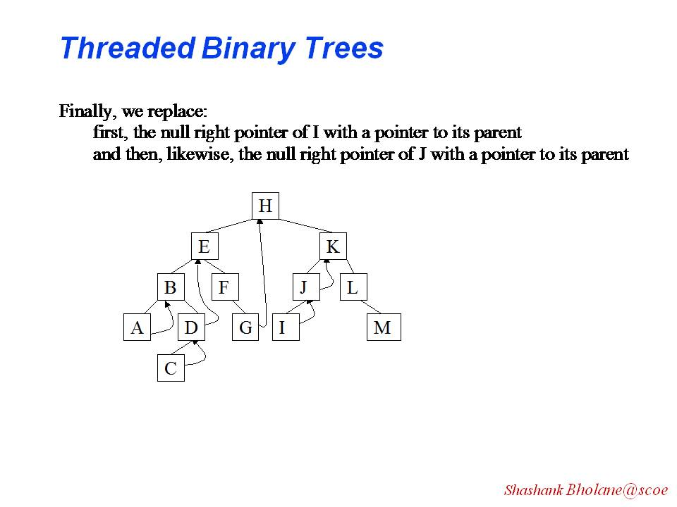

Slide 107
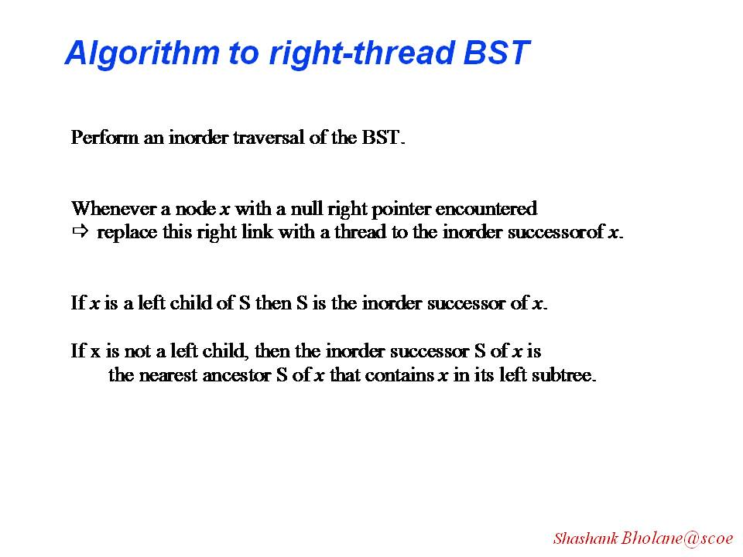

Slide 108
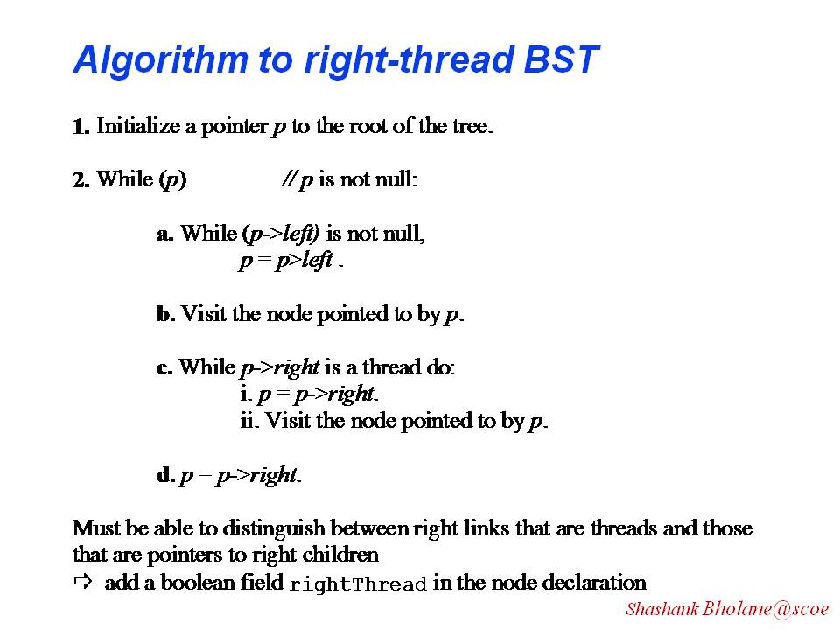

Slide 109
Differentiation between thread and child:
lbit of a node=1 left child exist
lbit of a node=0 left child not exist so thread to inorder predecessor
rbit of a node=1 left child exist
rbit of a node=0 left child not exist so thread to Inorder successor

Slide 110
Class node
{
int data;
node * left;
node *right;
int lbit,rbit
node(int val)
{
left=right=NULL;
data =val;
lbit=rbit=0;
}
};
lbit left* data right* rbit

Slide 111
Steps Inserting a Node at left side:
Node *Current =maketree(val);
Current ->left=temp->left
2. Current ->right=temp;
3. temp->left=current
4 temp->lbit=1
5 Insert flag=1

Slide 112
Steps Inserting a Node at right side:
Node *Current =maketree(val);
Current ->left=temp
2. Current ->right=temp->right
3. temp->right=current
4 temp->rbit=1
5 Insert flag=1

Slide 113
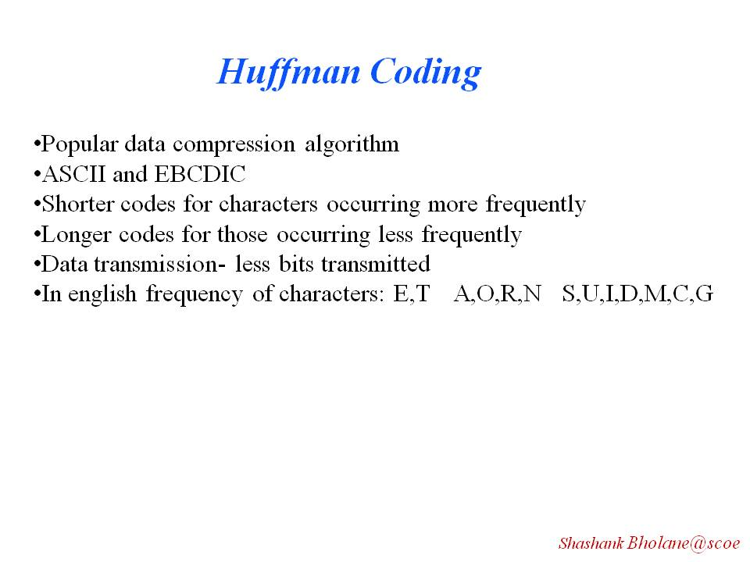
Application of Binary Tree

Slide 114
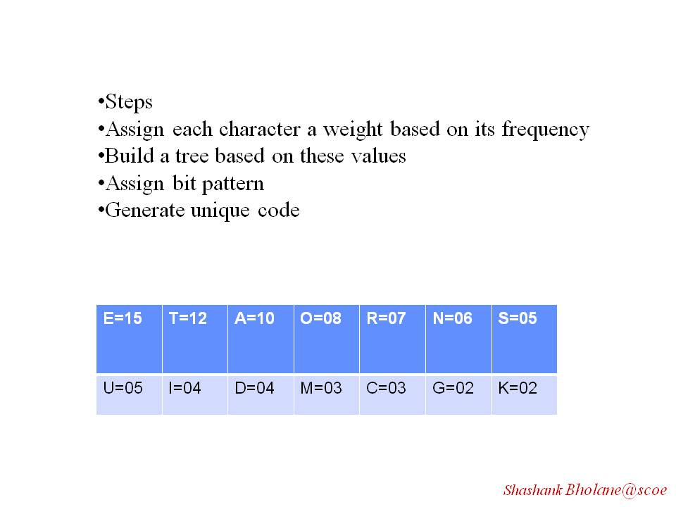

Slide 115
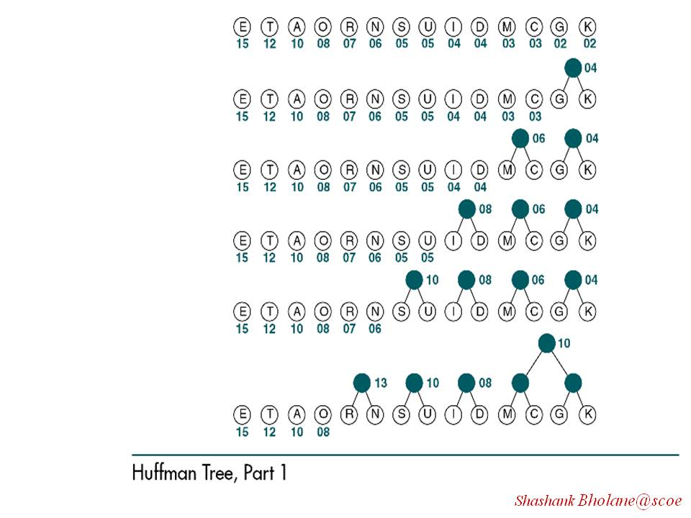

Slide 116
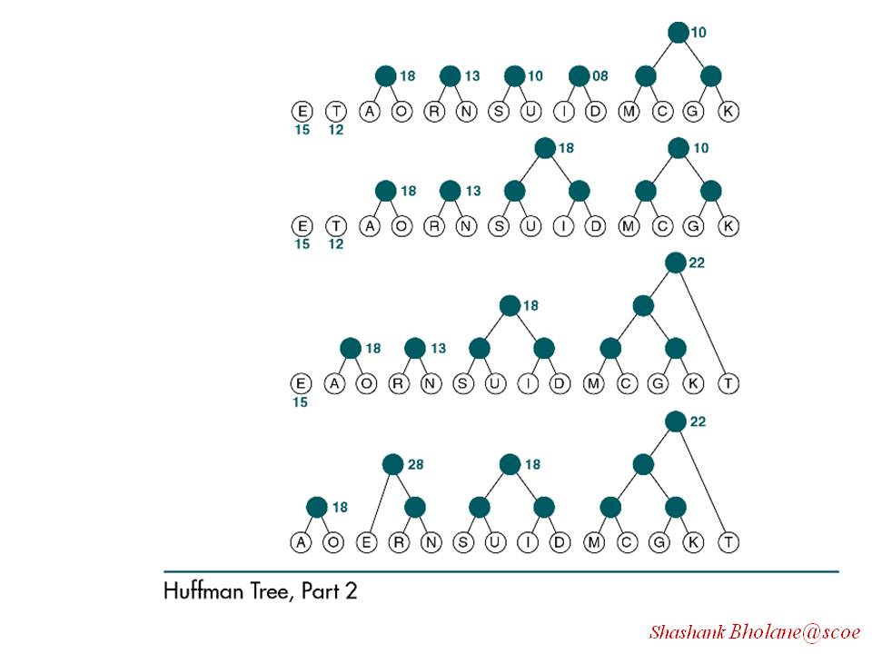

Slide 117
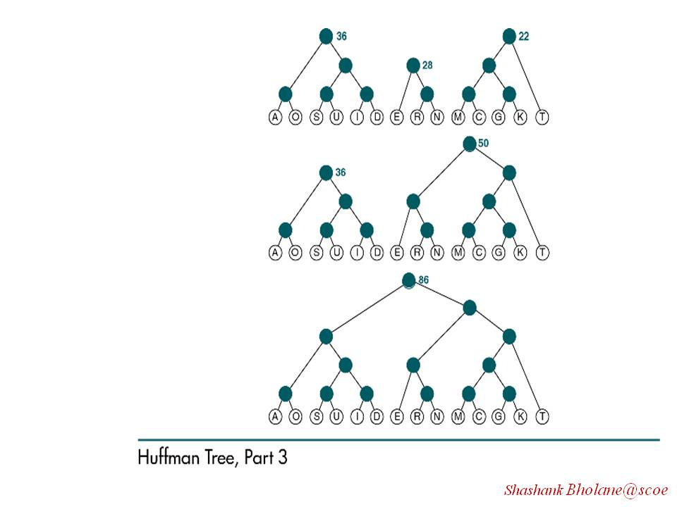

Slide 118


Slide 119
Some other Algorithmic Application of Binary Tree:
Gaming like Tic – Tac _Toe
Decision tree which is used in data base applications like mining

Slide 120


