Slide 1
Memory Management Unit and Segment Description and Paging
80386Dx descriptor Tables GDT, LDT, IDT, descriptor cache,
Code, data and stack descriptors,
system descriptors,
privilege levels,
Segmentation in 80386DX, comparison of segmentation with 8086,
paging, TSS, Nested Tasks,
Operating in Real Mode, Protected Mode, Virtual 86 mode, Virtual addressing

Slide 2
80386Dx descriptor Tables
Segmentation is one method of memory management.
Segmentation provides the basis for protection.
All information about a
segment is stored in an 8 byte data structure called a descriptor.
All of the descriptors in a system are contained in tables recognized by hardware.

Slide 3
Terminology
PL: Privilege Level- One of the four hierarchical
privilege levels. Level 0 is the most privileged level
and level 3 is the least privileged. More privileged
levels are numerically smaller than less privileged
levels.
RPL: Requestor Privilege Level-The privilege level
of the original supplier of the selector. RPL is determined by the least two significant bits of a selector.

Slide 4
Terminology
DPL: Descriptor Privilege Level-This is the least privileged level at which a task may access that descriptor.
CPL: Current Privilege LevelÐThe privilege level at which a task is currently executing, which equals the privilege level of the code segment being executed.

Slide 5
Terminology
EPL: Effective Privilege Level-The effective privilege level is the least privileged of the RPL and DPL. Since smaller privilege level values indicate greater privilege.
Task: One instance of the execution of a program.Tasks are also referred to as processes.

Slide 6
DESCRIPTOR TABLES INTRODUCTION
The descriptor tables define all of the segments which are used in an Intel386 DX system.
Global Descriptor Table (GDT)
Local Descriptor Table(LDT)
Interrupt Descriptor Table(IDT)
Tables are variable length memory arrays.

Slide 7
DESCRIPTOR TABLES INTRODUCTION
range in size between 8 bytes and 64K bytes. Each table can hold up to 8192 8 byte descriptors.
The upper 13 bits of a selector are used as
an index into the descriptor table.
The tables have registers associated with them which hold the 32-bit linear base address, and the 16-bit limit of each table.

Slide 8
DESCRIPTOR TABLES INTRODUCTION
Each of the tables has a register associated with it the GDTR, LDTR, and the IDTR
The LGDT, LLDT, and LIDT instructions, load the
base and limit of the Global, Local, and Interrupt Descriptor Tables, respectively.
SGDT, SLDT, and SIDT instructions store the base and limit values.
These tables are manipulated by the operating system.

Slide 9
GLOBAL DESCRIPTOR TABLE

Slide 10
GLOBAL DESCRIPTOR TABLE
contains descriptors which are possibly available to all of the tasks in a system.
GDT contains code and data segments used by the operating systems and task state segments, and descriptors for the LDTs in a system.
The first slot of the Global Descriptor Table corresponds to the null selector and is not used. The null selector defines a null pointer value

Slide 11
LOCAL DESCRIPTOR TABLE

Slide 12
LOCAL DESCRIPTOR TABLE
LDTs contain descriptors which are Task Specific.
LDT may contain only code, data, stack, task gate and call gate descriptors.
LDTs isolates a given task's code and data segments from the rest of the OS.
Unlike the 6 byte GDT or IDT registers, the visible portion of LDT register contains only a 16-bit selector.
This selector refers to a Local Descriptor Table Descriptor in the GDT.

Slide 13
Interrupt Descriptor Table
IDT contains descriptors to point to the location of up to 256 interrupt service routines.
IDT should be atleast 256 bytes to hold 32 Intel Reserved Interrupts(32*8)
Every interrupt used must have an entry in IDT.
IDT entries are referenced via INT instructions, external interrupt vectors and exceptions.

Slide 14
Interrupt Descriptor Table
Interrupts handle asynchronous external events(eg.pressing a key) and exceptions handle instruction faults (e.g. page permission fault)

Slide 15
Interrupt Descriptor Table

Slide 16
Descriptors
The object to which the segment selector points to is called a descriptor.
Descriptors are 8 byte quantities which contain 32 bit base address, 20-bit limit and attributes (12 bits) about a given segment.
(ref word document )

Slide 17
General Format of a Descriptor

Slide 18
Segments
Two main categories of segments
-system segments
-non-system segments( for code and data)

Slide 19
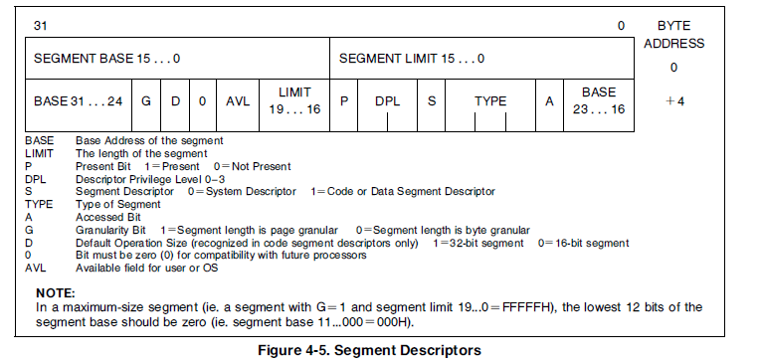
DESCRIPTOR ATTRIBUTE BITS

Slide 20
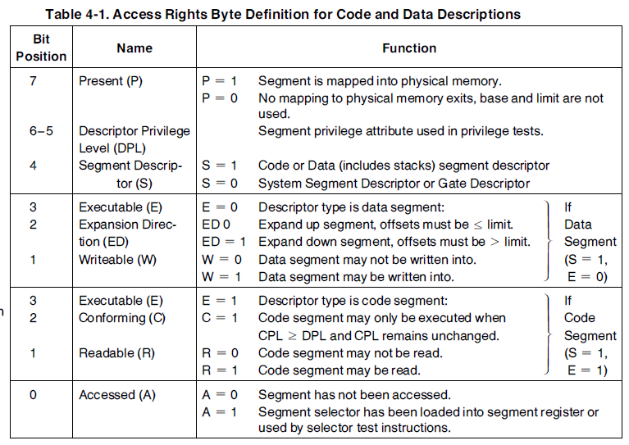

Slide 21
SYSTEM DESCRIPTOR FORMATS
System segments describe information about operating system tables, tasks, and gates.
System descriptors contain a 32-bit base linear address and a 20-bit segment limit.

Slide 22
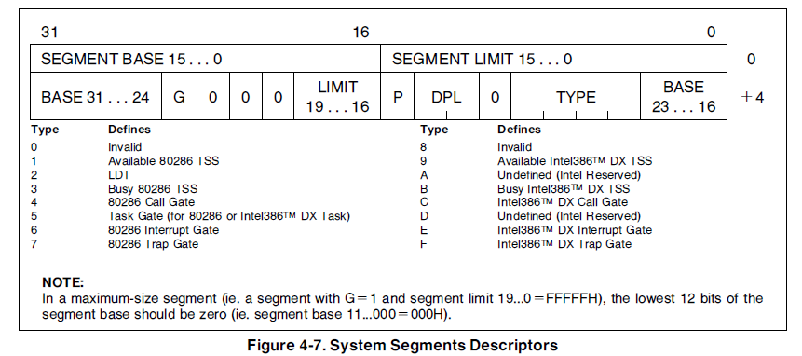

Slide 23
LDT DESCRIPTORS (S=0, TYPE=2)
It contain information about LDT.
LDTs contain a table of segment descriptors, unique to a particular task. Since the instruction to load the LDTR is only available at privilege level 0, the DPL field is ignored.
LDT descriptors are only allowed in the Global DescriptorTable (GDT).

Slide 24
TSS DESCRIPTORS (S=0, TYPE=1, 3, 9, B)
It contains information about the location, size, and privilege level of (TSS).
special fixed format segment which contains all the
state information for a task and a linkage field to permit nesting tasks.
The TYPE field is used to indicate whether the task is currently BUSY (i.e. on a chain of active tasks) or the TSS is available, indicates if the segment contains a 80286 or an Intel386 DX TSS.
The Task Register(TR) contains the selector which points to the current Task State Segment.

Slide 25
GATE DESCRIPTORS (S=0, TYPE=4-7, C, F)
Gates are used to control access to entry points within the target code segment.
Gates provide a level of indirection between the source and destination of the control transfer.
Types:
call gates(to change privilege levels),
task gates(used to perform a task switch)
interrupt gates, and trap gates( to specify interrupt
service routines).

Slide 26
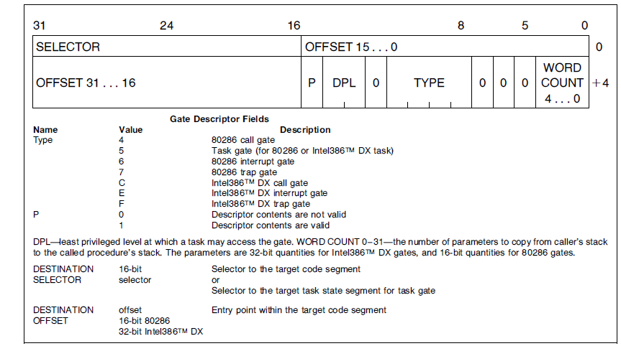
Gate Descriptor Format

Slide 27
Gate Descriptor Format (Call Descriptor)
used to transfer program control to a more privileged level.
The call gate descriptor consists of three fields:
the access byte, a long pointer (selector and offset) which points to the start of a routine , a word count specifies how many parameters are to be copied from the caller's stack to the stack of the called routine. field is only used by call gates when there is a change in the privilege level,
other types of gates ignore it.

Slide 28
Gate Descriptor Format (Interrupt and Trap gates )
use the destination selector and destination offset fields of the gate descriptor as a pointer to the start of the interrupt or trap handler routines.
the interrupt gate disables interrupts(resets the IF bit) while the trap gate does not.

Slide 29
Gate Descriptor Format (Task Gate)
Used to switch tasks.
may only refer to a task state segment therefore only the destination selector portion of a task gate descriptor is used, and the destination offset is ignored.
Exception 13 is generated when a destination selector does not refer to a correct descriptor type, i.e., a code segment for an interrupt, trap or call gate, a TSS for a task gate.

Slide 30
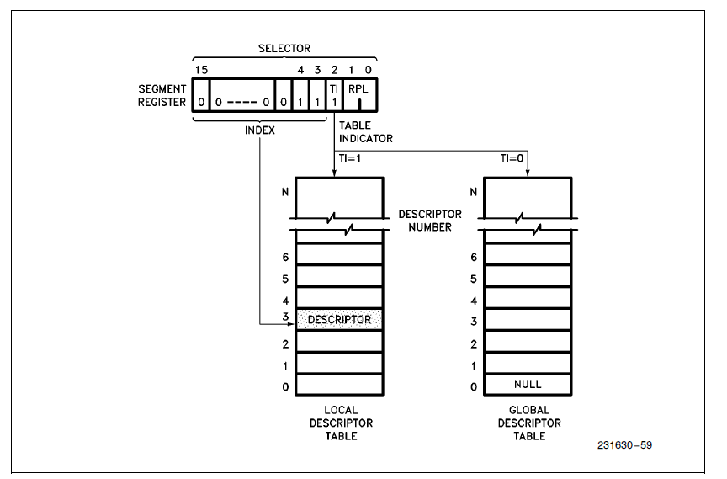
SELECTOR FIELDS

Slide 31
SELECTOR FIELDS
A selector in Protected Mode has three fields:
1. Local or Global Descriptor Table Indicator (TI), Descriptor(select one of two memory-based tables of descriptors GDT or LDT)
2. Entry Index (Index):selects one of 8K descriptors in the appropriate descriptor table.
3. Requestor (the selector's) Privilege Level (RPL):allow high speed testing of the selector's
privilege attributes.

Slide 32
SEGMENT DESCRIPTOR CACHE
Every segment register has a segment descriptor cache register associated with it.
Whenever a segment register's contents are changed, the 8-byte descriptor associated with that selector is automatically loaded (cached) on the chip.
Once loaded, all references to that segment use the cached descriptor information instead
of reaccessing the descriptor.
The contents of the descriptor cache are not visible to the programmer.

Slide 33
SEGMENT DESCRIPTOR REGISTER SETTINGS
The contents of the segment descriptor cache vary depending on the mode the Intel386 DX is operating in.
Real Address Mode:the base is set to sixteen times the current selector value, the limit is fixed at 0000FFFFH,
the attributes are fixed(present ,fully usable)
``privilege level'' is always fixed-level 0. so I/O and other privileged opcodes may be executed.

Slide 34
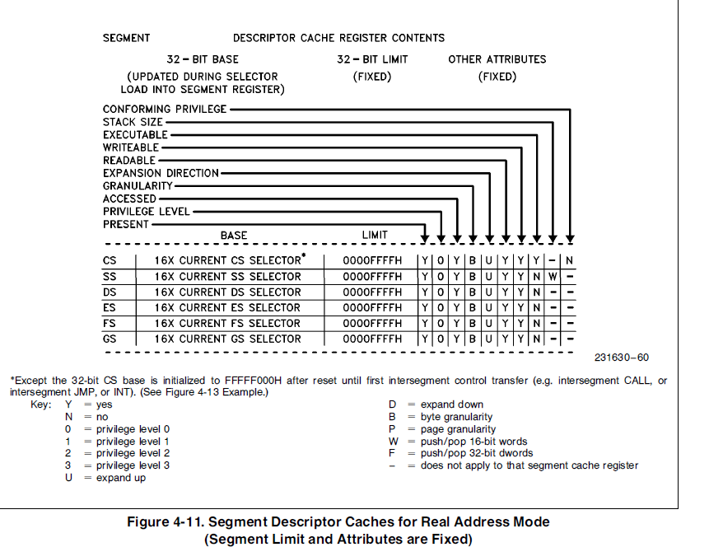

Slide 35
SEGMENT DESCRIPTOR REGISTER SETTINGS
In Protected Mode, :
each of these fields are defined according to the contents of the segment descriptor indexed by the selector value loaded into the segment register

Slide 36
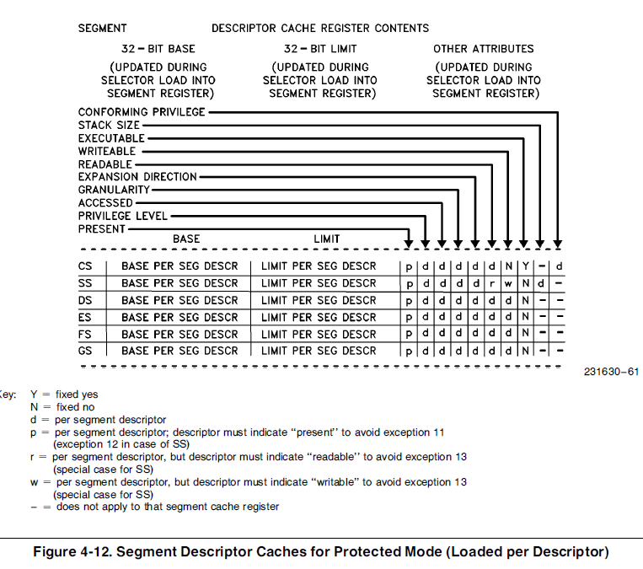

Slide 37
Protection Level
has four levels of protection which isolate and protect user programs from each other and the operating system.
The privilege levels control the use of
privileged instructions
I/O instructions
access to segments and segment descriptors.
Intel386 DX provides protection as part of its Memory Management Unit.
It offers an additional type of protection on a page basis, when paging is enabled(using U/S and R/W fields)

Slide 38
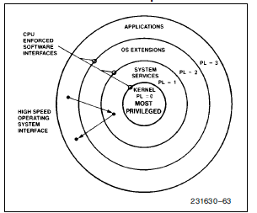
Four-level hierarchical privilege system

Slide 39
Protection Level
- Privilege protection (PL0-PL3 )
PL0 –most Protection Level
P3- least Protection Level

Slide 40
Rules for Privileges
Intel 386Dx controls access to both data and procedures according to the following rules:
Data stored in a segment with privilege level p can be accessed only by the code executing at a privilege level at least as privileged as p
A code segment/procedure with a privilege level p can only be called by a task executing at the same or lesser privilege level than p

Slide 41
Protection Level
Privilege assigned to the entire segment .
PL of Segment is stored in the corresponding segment descriptor.
Anything stored within segment has same PL as that of segment.
CPL:Current PL of currently executing program or code
RPL: Requestors PL (PL of the program requesting the segment access)

Slide 42
Current Privilege Level(CPL)
Also called Task Privilege Level
It specifies privilege level of currently executing task
A task’s CPL can only be changed by control transfers through gate descriptors to a code segment with a different privilege level.
E.g. an application program running at PL = 3 may call an OS routine at PL = 1 (via a gate) which would cause the task's CPL to be set to 1 until the OS routine is finished.
Normally, CPL = DPL of the segment that the processor is currently executing.
CPL changes as control is transferred to segments with differing DPLs.

Slide 43
Requestor Privilege Level (RPL)
RPL is the two least significant bits of selector
RPL is used to establish a less trusted privilege level than CPL for the use of a segment and this level is called the task's Effective Privilege Level (EPL).
EPL is defined as
EPL = max { RPL,CPL } (numerically)
Thus the task becomes less privileged
E.g. If RPL = 2 and CPL = 1, EPL = 2 ➔ task became less privileged

Slide 44
Descriptor Privilege Level (DPL)
It is the least privileged level at which a task may access that descriptor and the segment associated with that descriptor
It is contained in the access right byte of the descriptor of the segment

Slide 45
Types of Checks
When running in Protected Mode 386DX continually checks that application is privileged enough to
1. Execute certain instructions.: affects segmentation, protection mechanisms ,alter IF flag or perform peripheral I/O.
e.g. HLT,LGDT,LIDT,LTR,LMSW
2. Reference data other than its own.
3. Transfer control to code other than its own. :
not allowed to CALL or JMP to code that does not have exactly the same PL that they do.

Slide 46
IOPL Sensitive Instructions
Affect I/O operations can be performed if CPL<= IOPL field in the EFLAGS register.
E.g. CLI,STI IN,INS,OUT,OUTS
Application can be denied access to I/O if CPL>IOPL .The two IOPL bits can be changed only if code is in a PL 0 segement.

Slide 47
Restricting Access to Data
The processor automatically evaluates access to a data segment by comparing privilege levels.
The evaluation is performed at the time a selector for the descriptor of the target segment is loaded into the data-segment register.
Instructions may load a data-segment register only if DPL(data) ≥ max {CPL(proc),RPL} numerically
A procedure can only access data that is at the same or less privileged level.

Slide 48
Privilege Check for Data Access

Slide 49
Privilege Check for Control Transfer(Code Access)
Control transfers (except interrupts) are accomplished by the instructions JMP, CALL, and RET
The "near" forms of JMP, CALL, and RET transfer within the current code segment and hence does not require privilege checks.
The "far" forms of JMP and CALL refer to other segments and hence requires privilege checking.
There are two ways a JMP or CALL can transfer to another segment

Slide 50
Privilege Check for Control Transfer(Code Access)
1. Without call gate
2. With call gate
There are two types of code segments:
Conforming Code Segment
Nonconforming Code Segment

Slide 51
Conforming Code Segment
An executable segment whose descriptor has the conforming bit set
It permits sharing of procedures that may be called from various privilege levels but should execute at the privilege level of the calling procedure.
Example: math libraries
When control is transferred to a conforming segment, the CPL does not change

Slide 52
Conforming Code Segment
Do not have any particular PL associated with them .
DPL of conforming CS must always be less than or equal to the current CPL .

Slide 53
Nonconforming Code Segment
Most code segments are not conforming
For nonconforming segments, control can be transferred without a gate only to executable segments at the same level of privilege
To transfer control to higher privilege levels(not numerical)-for e.g. application want to use system service- CALL instruction need to be used with call-gate descriptors
JMP instruction never transfer control to a nonconforming segment whose DPL ≠ CPL.

Slide 54
Privilege Check for Control Transfer without Gate

Slide 55
Call Gates
A call gate descriptor may reside in GDT or LDT
A call gate has two primary functions:
To define an entry point of a procedure
To specify the privilege level of entry point
The selector and offset fields of a gate form a pointer to the entry point of a procedure
Selector :gives the code segment that contains the routine to which the control is to be redirected.
Offset : offset of the instruction in that segment where execution is to be restarted.

Slide 56
Call Gate Format

Slide 57
Operation of Call Gate Mechanism

Slide 58
Privilege-level check for control Transfer

Slide 59
Privilege requirements to use Call gate
Call gate DPL >= CPL
Call gate DPL >= RPL(Gate Selector)
Call gate DPL >= DPL (Target CS)
Target CS DPL <=CPL

Slide 60
Paging
Used for virtual memory multitasking operating system.
Pages are fixed size portions of the program module or data
The complete task need not be in physical memory at any time and only a few pages are required. Hence the remaining space can be allocated for other tasks and thus multitasking can be achieved

Slide 61
Page Mechanism
Intel386DX uses a two level table mechanism to convert linear address to physical address.
There are 3 components in paging mechanism:
Page Directory
Page Table
Page Frame (page itself)
Page size of Intel 386DX is 4KB

Slide 62
Paging Mechanism

Slide 63
Paging Mechanism
PAGE DESCRIPTOR BASE REGISTER

Slide 64
CR2 is used to store the 32-bit linear address of page fault.
CR3 (Page Directory Physical Base Address Register) stores the physical starting address of Page Directory.
The lower 12 bits of CR3 are always zero to ensure that the Page Directory is always page aligned
Loading it via a MOV CR3, reg instruction causes Page Table Entry cache to be flushed and a task switch through a TSS changes the value of CR0.

Slide 65
Page Directory
It is at the most 4KB in size and allows upto 1024(only 10bits from linear address) entries are allowed.
The upper 10 bits of the linear address are used as an index to corresponding page directory entry
Page directory entry points to page tables.

Slide 66
Paging Mechanism
Page Directory Entry(Points to Page Table)

Slide 67
Page Tables
Each Page Table is 4K bytes and holds up to 1024 Page Table Entries(PTE).
PTEs contain the starting address of the page frame and statistical information about the page.
The 20 upperbit page frame address is concatenated with the lower 12 bits of the linear address to form the physical address.
Page tables can be shared between tasks and swapped to disks.

Slide 68
Page Table Entry

Slide 69
Page Table Entry
P(Present)Bit: indicates if PDE/PTE can be used in address translation. P-bit of the currently executed page is always high.
A (Accessed) Bit: It is set before any access to the page.
D (Dirty) bit: It is set before a write operation to the page is carried out. The D bit is undefined for PDEs.
OS Reserved Bits: They are defined by the operating system software.
U/S (0➔Supervisor/1➔User)Bit and R/W (0➔Read/1➔Write) Bit: They are used to provide page level or page table level protection. They are decoded as
Supervisor level (U/S=0) ── for the operating system and other systems software and related data.
User level (U/S=1) ── for applications procedures and data.
Read-only access (R/W=0)
Read/write access (R/W=1)

Slide 70
Page Level Protection
(R/W, U/S Bits)
.The paging mechanism distinguishes between two levels of protection:
User : which corresponds to level 3 of the segmentation based protection
supervisor which encompasses all of the other protection levels (0, 1, 2).
Programs executing at Level 0, 1 or 2 bypass the page protection.
segmentation based protection is still enforced by the hardware.

Slide 71
Protection Provided by R/W and U/S

Slide 72
Translation Lookaside Buffer(TLB)
80386 supports demand paged virtual memory systems
Performance degrades if the processor access two levels of tables for every memory reference.
To solve this problem, the Intel386 DX keeps a cache of the most recently accessed pages and this cache is called Translation Lookaside Buffer (TLB).
TLB is a 4 way set associative 32 entry page table cache

Slide 73
Translation Lookaside Buffer(TLB)
It automatically keeps the most commonly used Page Table Entries in the processor.
The 32-entry TLB coupled with a 4K page size,
results in coverage of 128K bytes of memory addresses.

Slide 74
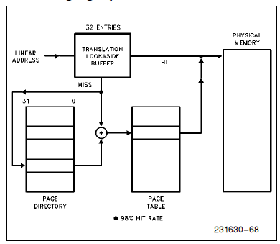
Translation Lookaside Buffer(TLB)

Slide 75
Paging Operation
Paging unit receives a 32-bit linear address from the segmentation unit.
The upper 20 linear address bits are compared with all 32 entries in the TLB to determine if there is a match.
If there is a match (i.e. a TLB hit), then the 32-bit physical address and will be placed on the address bus.
However, if PTE entry is not in TLB, the Intel386 DX will read the appropriate PDE Entry.
If P = 1 on PDE (➔the page table is in memory), then the Intel386 DX will read the appropriate PTE and set the Access bit.
If P = 1 on PTE (➔ the page is in memory), then the Intel386 DX will update the Access and Dirty bits as needed and fetch the operand.
The upper 20 bits of the linear address read from the page table will be stored in the TLB for future accesses.
If P = 0 for either PDE or PTE, then the processor will generate a page fault exception
This exception is also generated when protection rules are violated and the CR2 is loaded with the page fault address

Slide 76
Task : collection of code and data that has a TSS assigned to it.
One to one correlation between TSS and tasks.
TSS: area of read/write memory like small data segment
Not accessible to the general user program,only accessible to 80386 only.

Slide 77
Task Switching
The multitasking/multiuser OS needs the ability to rapidly switch between tasks.
Intel 386DX supports this operation by providing a task switch instruction hardware.
The task switch operation
saves the entire state of the machine(all of reg.s,address space and a link to previous task),
loads a new execution state,
performs protection checks and
commences execution in the new task
in about 17 μs.
The task switch operation is invoked by an intersegment JMP or CALL instruction which refers to a TSS or task gate descriptor in GDT or LDT
The TSS Descriptor points to a segment containing the entire execution state while a Task Gate Descriptor contains a TSS Selector

Slide 78
Task Gate Descriptor

Slide 79
TSS Descriptor

Slide 80
TSS Descriptor
B-bit : indicates whether the task is busy.
type code of 9 indicates a non-busy task.
type code of 11 indicates a busy task.
Tasks are not reentrant. The B-bit allows the processor to detect an attempt to switch to a task that is already busy.

Slide 81
TSS Descriptor
BASE, LIMIT, and DPL fields and the G-bit and P-bit have functions similar to data-segment descriptors.
TSS descriptors may reside only in the GDT.
to identify a TSS with a selector that has TI=1 (indicating the current LDT) results in an exception.

Slide 82
TSS
Each task must have a TSS associated with it.
TSS is defined by a segment descriptor in a descriptor table. (GDT)
TR contains the selector referring to current TSS Descriptor.
Returning from a task is done by IRET
IRET makes the control transfer to the task which was interrupted and current task state is saved in TSS and old task state is restored from TSS

Slide 83
TSS

Slide 84
TSS
All information the processor needs to manage a task is stored in task state segment (TSS).
The fields of a TSS belong to two classes:

Slide 85
TSS
Dynamic set : processor updates with each task switch . It includes the fields that store:
General registers (EAX, ECX, EDX, EBX, ESP, EBP, ESI, EDI)
The segment registers (ES, CS, SS, DS, FS, GS).
The flags register (EFLAGS).
The instruction pointer (EIP).
The selector of the TSS

Slide 86
TSS
Static set : the processor reads but does not change.
This set includes the fields that store:
The selector of the task's LDT.
Page Directory Base Register (PDBR)
Pointers to the stacks.
T-bit (debug trap bit)
I/O map base

Slide 87
Task Linking
The back-link field of the TSS and the NT (nested task) bit of the flag word together allow the 80386 to automatically return to a task that CALLed another task or was interrupted by another task.
When a CALL instruction, an interrupt instruction, an external interrupt, or an exception causes a switch to a new task
the 80386 automatically fills the back-link of the new TSS with the selector of the outgoing task's TSS and, sets the NT bit in the new task's flag register.
The NT flag indicates whether the back-link field is valid. The new task releases control by executing an IRET instruction.
When interpreting an IRET, the 80386 examines the NT flag. If NT is set, the 80386 switches back to the task selected by the back-link field.

Slide 88
Busy Bit Prevents Loops
The B-bit (busy bit) of the TSS descriptor ensures the integrity of the back-link.
A chain of back-links may grow to any length (nested task)
B-bit ensures that the CPU can detect any attempt to create a loop.

Slide 89
Busy Bit Prevents Loops
The processor uses the busy bit as follows:
1. When switching to a task, the processor automatically sets the busy bit of the new task.
When switching from a task, the processor automatically clears the busy bit of the old task if that task is not to be placed on the back-link chain (i.e., the instruction causing the task switch is JMP or IRET). If the task is placed on the back-link chain, its busy bit remains set.
When switching to a task,the processor signals an exception if the busy bit of the new task is already set.

Slide 90
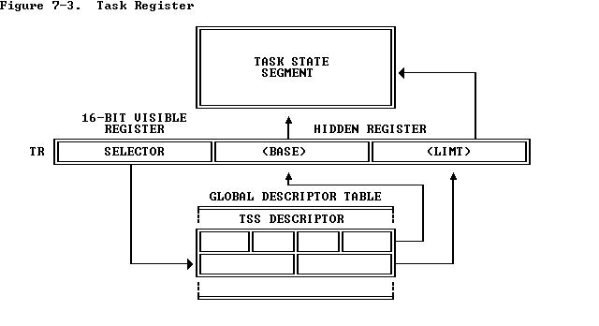
Task Register
Identifies the currently executing task by pointing to the TSS.

Slide 91
Task Register
"visible" portion :can be read and changed by instructions.
"invisible" portion : cannot be read by any instruction.
Selector: visible portion, selects a TSS descriptor in the GDT.
The processor uses the invisible portion to cache the base and limit values from the TSS descriptor.
Holding the base and limit in a register makes execution of the task more efficient, because the processor does not need to repeatedly fetch these values from memory when it references the TSS of the current task.

Slide 92
Task Register Instructions
LTR and STR are used to modify and read the visible portion of the task register.
LTR (Load task register) loads the visible portion of the task register with the selector operand, which must select a TSS descriptor in the GDT.
LTR also loads the invisible portion with information from the TSS descriptor selected by the operand.
LTR is a privileged instruction , executed (CPL=0) .
LTR used during system initialization to give an initial value to the TR, the contents of TR are changed by task switch operations.
STR (Store task register) stores the visible portion of the task register in a general register or memory word. STR is not privileged.

Slide 93
Task Switching
The 80386 switches execution to another task in any of four cases:
1. The current task executes a JMP or CALL that refers to a TSS
descriptor.
2. The current task executes a JMP or CALL that refers to a task gate.
3. An interrupt or exception vectors to a task gate in the IDT.
4. The current task executes an IRET when the NT flag is set.

Slide 94
Task Switching Operation
Checking that
The current task is allowed to switch to the designated task.
DPL (TSS descriptor or task gate) <= max (CPL , RPL) of the gate selector.
TSS descriptor of the new task is marked present and has a valid limit.

Slide 95
Task Switching Operation
Saving the state of the current task. The processor finds the base address of the current TSS cached in the task register. It copies registers into the current TSS (EAX, ECX, EDX, EBX, ESP, EBP, ESI, EDI, ES, CS, SS, DS, FS, GS, and the flag register). The EIP field of the TSS points to the instruction after the one that caused the task switch.

Slide 96
Task Switching Operation
Loading the task register with the selector of the incoming task's TSS descriptor, marking the incoming task's TSS descriptor as busy, and setting the TS (task switched) bit of the MSW.
Loading the incoming task's state from its TSS and resuming execution.

Slide 97
Task Gate Descriptor
provides an indirect, protected reference to a TSS

Slide 98
Task Gate Descriptor
SELECTOR field of a task gate must refer to a TSS descriptor.
DPL field of a task gate controls the right to use the descriptor to cause a task switch.
A procedure may not select a task gate descriptor unless the max (RPL ,CPL) of <= DPL of the descriptor. This constraint prevents untrusted procedures from causing a task switch.

Slide 99
Task Gate Descriptor
A procedure that has access to a task gate has the power to cause a task switch.
The 80386 has task gates in addition to TSS descriptors to satisfy three needs:
1.The need for a task to have a single busy bit
2.The need to provide selective access to tasks
3.The need for an interrupt or exception to cause a task switch

