Slide 1
Operating System
It is the interface between user (application programs) and hardware.
It is a program that controls the execution of application programs and acts as an interface between the user of a computer and the computer hardware.
Operating system is a software that enables all the programs we use.
Examples – Windows, Linux, Unix, etc.

Slide 2
Operating System Goals
Execute user programs and make solving user problems easier.
Use the computer hardware in an efficient manner.
Operating system performs basic tasks such as,
Controlling and allocating memory
Execute system requests as per their priority.
Controlling i/p and o/p devices.
Managing file systems.

Slide 3
Features of Operating System
Multiprogramming : it is a technique to execute number of programs simultaneously by a single processor.
Multitasking : Multiple jobs are executed by switching the CPU between them. In this, the CPU time is shared by different processes, so it is called as “Time sharing systems”. Multitasking or Time sharing is a logical extension of Multiprogramming.

Slide 4
UNIX operating system is popular from its beginning (from 1969), running on machines of varying processing power from microprocessor to mainframes and providing a common execution environment across them.
UNIX OPERATING SYSTEM
UNIX operating system is divided into two parts, first part consists of programs and services and second part consists of the operating system that supports these programs and services.

Slide 5
UNICS ( Uniplexed Information Computing System) → UNIX OS developed in 1969 by AT and T Bell lab in USA. UNIX OS is written in C language. It is designed by Ken Thompson. UNIX OS was first installed in PDP/7 machine.
Unix system support other languages, including Fortran, Basic, Pascal, Ada, Cobol, Lisp, Prolog and also support any language that has a comipler or interpreter.
Linux is the full name of the Kernel. It was created as a combination of the phrase “Linus UNIX”, after the original author Linus Torvalds.

Slide 6
Several reasons for popularity and success of the UNIX system :
1. System is written in a high-level language - easy to read, understand, change, move to other machine.
2. It has a simple user interface.
3. It provides many primitives that permit complex programs to be built from simpler programs.
4. It uses a hierarchical file system that allows easy maintenance and efficient implementation.
5. It uses a consistent file format (byte stream) - making programs easier to write
6. It provides a simple, consistent interface to peripheral devices.
7. It is a multi-user, multi-process system, each user can execute several processes simultaneously.

Slide 7
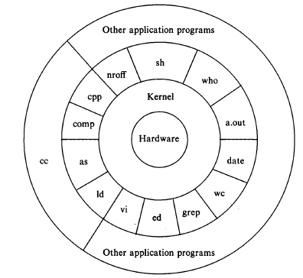
Unix system structure
Figure. Architecture of Unix OS

Slide 8
H/w at the centre provides the OS with basic services.
OS interacts directly with the H/w, providing common services to programs
Application programs interact with the kernel by invoking a well defined set of system calls.
System calls instruct the kernel to do various operations for the calling program and exchange data between the kernel and the program.
a.out – the standard name for executable files produced by the C compiler.
Set of system calls and the internal algorithms that implement them form the body of the kernel.

Slide 9
User Perspective
High level features of the Unix system such as :
File system
Processing environment
Building block primitives

Slide 10
1. File System
The Unix file system is characterized by :
A hierarchical structure – as a tree with a root
Consistent treatment of file data – unformatted stream of bytes
The ability to create and delete files
Dynamic growth of files
The protection of file data – access permissions for three classes of users
The treatment of peripheral devices (such as terminals and tape units) as files

Slide 11
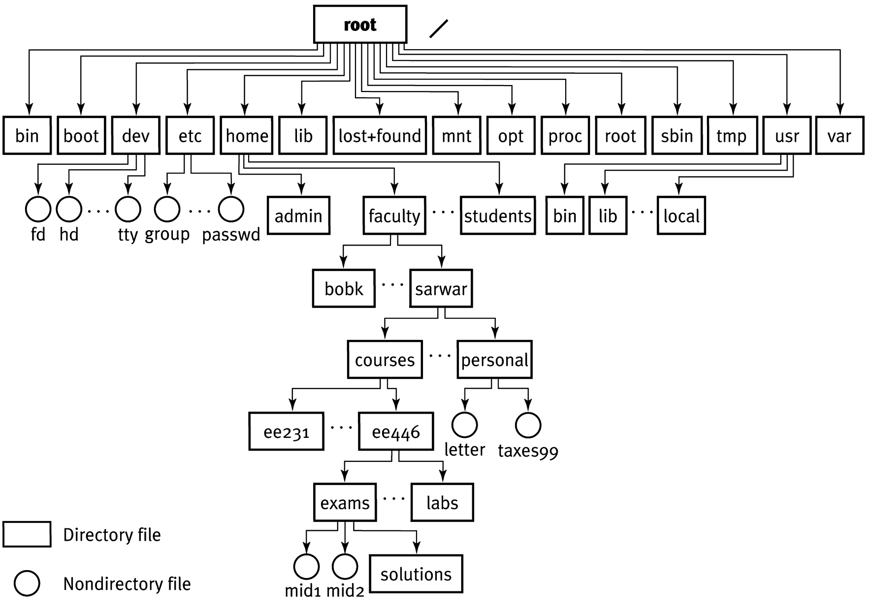
Figure. File System Tree

Slide 12
The file system is organized as a tree with a single root node (written “/”), every non-leaf node of the file system structure is a directory of files, and files at the leaf nodes of the tree are either directories, regular files, or special device files.
The name of a file is given by a path name that describes how to locate the file in the FS hierarchy.
A path name is a sequence of directory names separated by slash character that designates a file name.

Slide 13
A full path name starts with a “/” and specifies a file that can be found by starting at the FS root and traversing the file tree, following the branches that lead to successive directory names of the path name.
Programs in the Unix system have no knowledge of the internal format in which the kernel stores file data, treating the data as an unformatted stream of bytes.
Programs may interpret the byte stream as they wish, but the interpretation has no bearing on how the operating system stores the data .

Slide 14
The syntax of accessing the data in a file is defined by the system and is identical for all programs, but the semantics of the data are imposed by the program.
Directories are like regular files, the system treats the data in a directory as a byte stream, but the data contains the names of the files in the directory in a predictable format.

Slide 15
Permission to access a file is controlled by access permissions associated with the file.
Access permissions can be set independently to control read, write and execute permission for three classes of users : the file owner, a file group, other users.
Users may create files if directory access permissions allow it. The newly created files are leaf nodes of the file system directory structure.
To the user, the Unix system treats devices as if they were files.

Slide 16
2. Processing Environment
Program - is an executable file
Process - is an instance of the program in execution (program executing).
Many processes can execute simultaneously on Unix systems (multiprogramming/multitasking) with no logical limit to their number and many instances of a program can exist simultaneously in the system.

Slide 17
Various system calls allow processes to create new processes, terminate processes, process execution and control reaction to various events.
Four major system calls used for process control – fork, exec, wait, exit.
Shell is a user program not the part of kernel.
Shell is just a process that uses fork/exec/wait.
Shell is the command interpreter program.

Slide 18
Shell searches for commands in a given sequence of directories.
Shell usually executes a command synchronously and asynchronously.
Synchronously – waiting for the cmd to terminate before reading the next cmd line.
Asynchronously – it reads the next cmd line and executes it without waiting for the prior cmd to terminate. Commands executed asynchronously are said to execute in the background..

Slide 19
Users can use the C shell to provide a history mechanism and avoid retyping recently used commands instead of the Bourne shell (named after its inventor, Steve Bourne).

Slide 20
3. Building Block Primitives
The Unix system to provide operating system primitives that enable users to write small, modular programs that can used as building blocks to build more complex programs.
The second building block primitive is the pipe - a mechanism that allows a stream of data to be passed between reader and writer processes.
Processes can redirect their standard output to a pipe to be read by other processes that have redirected their standard input to come from the pipe.

Slide 21
Operating System Services
Controlling the execution of processes : creation, termination, suspension, communication.
Scheduling of processes : processes share the CPU in a a time-shared manner, the CPU executes a process, the kernel suspends it when its time quantum elapses, and the kernel schedules another process to execute. The kernel later reschedules the suspended process.
Allocating main memory for an executing process. If the system runs low on free memory, the kernel frees memory by writing a process temporarily to secondary memory, called a swap device.

Slide 22
Allocating secondary memory for efficient storage and retrieval of user data.
Device management: hides device/regular file differences.

Slide 23
Assumptions About Hardware
The execution of user processes on Unix systems is divided into two levels:
User mode
Kernel mode
When a process executes a system call, the execution mode of the process changes from user mode to kernel mode.
Hardware supports mode switching

Slide 24
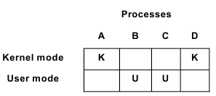
Operating system tracks processes and switches between them
The kernel distinguishes between processes and hardware distinguishes the mode of execution.
Process executing in kernel mode allocates the resources or does the various operation.

Slide 25
Processes in user mode, can access their own instructions and data but not kernel instructions and data.
Processes in kernel mode, can access kernel and user instructions and data.

Slide 26
Interrupts and Exceptions
Interrupts :
Devices (I/O peripherals) interrupt the system asynchronously.
On receipt of the interrupt, Kernel saves process current context ( a frozen image of what the process was doing), determines which interrupt occurred and "services" it. After interrupt servicing, kernel restores its interrupted context and proceeds process execution.
Traps - program initiated interrupts

Slide 27
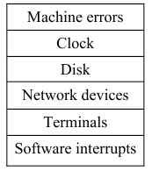
Device priorities are set in hardware design/cpu/interrupt handling circuitry.
When the kernel services an interrupt, it blocks out lower priority interrupts but services higher priority interrupts.
higher Priority
|
lower Priority
Interrupt Level

Slide 28
2. Exceptions :
Exceptions : refers to unexpected events caused by a process.
e.g., divide by zero, executing privileged instructions,
addressing illegal memory.
Exceptions happen “ in the middle “ of the execution of an instruction, and the system attempts to restart the instruction after handling the exception.
Interrupts are happen “between” the execution of two instructions, and the system continues with the next instruction after servicing the interrupt.

Slide 29
Memory Management
Kernel permanently resides in main memory.
When compiling a program, the compiler generates a set of addresses in the program that represent addresses of variables, and functions.
Compiler generates the addresses as if the only process in the system.

Slide 30
When the program is to run on the machine, the kernel allocates space in main memory for it, but the virtual addresses generated by the compiler need not be identical to the physical addresses that they occupy in the machine.
The kernel coordinates with the machine hardware to set up a virtual to physical address translation that maps the compiler-generated addresses to the physical machine addresses.
The mapping depends on the capabilities of the machine hardware.

