Slide 1
UNIT-II
Introduction To The Kernel

Slide 2
Contents
Architecture of Unix Operating System
Introduction to the System Concepts
An overview of the file subsystem
Processes
Context of a process
Process states
State transitions
Sleep and wakeup
Kernel Data Structure
System Administration

Slide 3
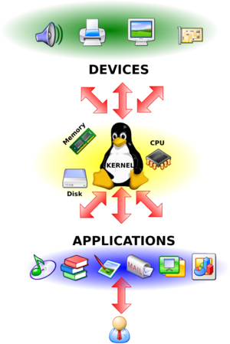
What is Kernel
It acts as an interface between the user applications and the hardware.
The main tasks of the kernel
are:
Process management
Device management
Memory management
Interrupt handling
I/O communication
File system...etc..

Slide 4
Contents
Architecture of Unix Operating System
Introduction to the System Concepts
An overview of the file subsystem
Processes
Context of a process
Process states
State transitions
Sleep and wakeup
Kernel Data Structure
System Administration

Slide 5
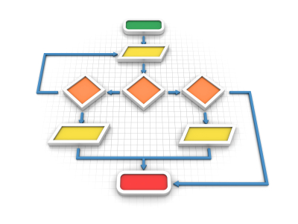
Architecture of the UNIX
Unix system supports two central concepts
File system : has “Places”
(basic unit of information storage)
- Processes : have “life”
(basic unit of computation)

Slide 6
Block Diagram of System Kernel
User Programs
User Level
Kernel Level
Trap
Libraries
System Call Interface
File Subsystem
Process
Control
Subsystem
Inter-process
Communication
Buffer Cache
Scheduler
Character
Block
Memory
Management
Device Drivers
Hardware Control
Kernel Level
Hardware Level
Hardware

Slide 7
System calls & Libraries
User Programs
User Level
Kernel Level
Trap
Libraries
System Call Interface
File Subsystem
Process
Control
Subsystem
Inter-process
Communication
Buffer Cache
Scheduler
Character
Block
Memory
Management
Device Drivers
Hardware Control
Kernel Level
Hardware Level
Hardware

Slide 8
System calls & Libraries
System call library
System calls in user programs looks like normal C function.
Then libraries maps them to primitives requires to enter in OS.
Standard library
User program uses libraries such as standard I/O .
Linked with the programs at compile time and are part of the user program

Slide 9
File Subsystem
User Programs
User Level
Kernel Level
Trap
Libraries
System Call Interface
File Subsystem
Process
Control
Subsystem
Inter-process
Communication
Buffer Cache
Scheduler
Character
Block
Memory
Management
Device Drivers
Hardware Control
Kernel Level
Hardware Level
Hardware

Slide 10
System calls & Libraries
System calls interacts with file subsystem
Managing files and structures of file system
Allocating file space
Administering free space
Controlling access to files
Retrieving data for users
System calls for process to interact with file subsystem
open (to open file for reading/writing) & close
read & write
stat (to query the attributes of file)
chown ( to change the record of who owns the file)
chmod (to change access permissions of a file)

Slide 11
Buffering Mechanism
User Programs
User Level
Kernel Level
Trap
Libraries
System Call Interface
File Subsystem
Process
Control
Subsystem
Inter-process
Communication
Buffer Cache
Scheduler
Character
Block
Memory
Management
Device Drivers
Hardware Control
Kernel Level
Hardware Level
Hardware

Slide 12
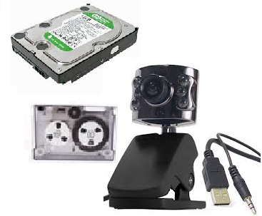
Buffering Mechanism (Cont..)
Interact with block I/O device drivers to initiate data transfer to and from kernel.
Device drivers are the kernel modules that controls operations of peripheral devices.
Block I/O devices are random access storage devices.
Such as Tape unit,
hard disk,
USB cameras etc.

Slide 13
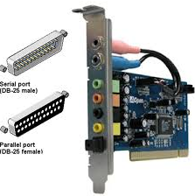
File Subsystem
File subsystem also interacts with “raw” I/O device drivers without buffering mechanism.
Raw devices also called as character devices.
Such as serial port,
parallel port,
sound cards, etc.

Slide 14
Process Control Subsystem
User Programs
User Level
Kernel Level
Trap
Libraries
System Call Interface
File Subsystem
Process
Control
Subsystem
Inter-process
Communication
Buffer Cache
Scheduler
Character
Block
Memory
Management
Device Drivers
Hardware Control
Kernel Level
Hardware Level
Hardware

Slide 15
Process Control Subsystem (Cont..)
Responsible for process synchronization
Inter-process communication (IPC)
Memory management
Process scheduling
Communicate with file subsystem
Loading a file into memory for execution
Interact with set of system calls
fork (to create new process)
exec (to overlay image of program onto running process)
exit (to finish executing process)
wait (synchronize process execution with exit of previously forked process)
brk (to control size of memory allocated to a process)
signal (to control process response to extraordinary events)

Slide 16
Process Control Subsystem (Cont..)
Memory management module
Control the allocation of memory to a process
In absence of enough memory kernel moves processes between main mem. & sec. mem.
Memory management is done with swapping & demand paging
Scheduler module
Allocate the CPU to processes
Interprocess communication
There are several forms.
Asynchronous signaling of events
Synchronous transmission of messages between processes.

Slide 17
Hardware Control
User Programs
User Level
Kernel Level
Trap
Libraries
System Call Interface
File Subsystem
Process
Control
Subsystem
Inter-process
Communication
Buffer Cache
Scheduler
Character
Block
Memory
Management
Device Drivers
Hardware Control
Kernel Level
Hardware Level
Hardware

Slide 18
Hardware Control (Cont..)
Responsible for handling interrupts and for communicating with the machine.
Devices such as disks or terminals may interrupt the CPU while a process is executing.
If so, kernel may resume execution of interrupted process after servicing the interrupt.

Slide 19
Contents
Architecture of Unix Operating System
Introduction to the System Concepts
An overview of the file subsystem
Processes
Context of a process
Process states
State transitions
Sleep and wakeup
Kernel Data Structure
System Administration

Slide 20
Files
What is file?
A container for data with name
contiguous / non-contiguous storage
Internal representation of a file is given by an inode, which contains a description of the disk layout of the file data and other information such as the file owner, access permissions and access times.
Inode - Index node

Slide 21
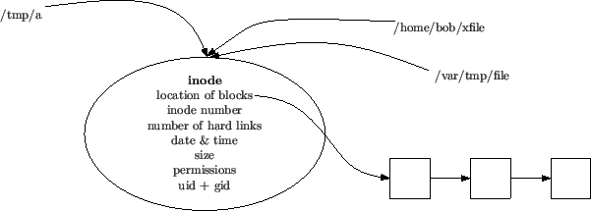
Overview of File Subsystem
Each file on disk has an associated data structure in the operating system, called an "inode"
Every file has one inode

Slide 22
Overview of File Subsystem (cont..)
When a process refers to a file by name the kernel parses the file name one directory at a time, checks that the process has permission to search the directories in the path and retrieves the inode for the file.
E.g. if a process calls – open(“/home/sam/sample.c”,1), the kernel retrieves the inode for “/home/sam/sample.c”.

Slide 23
Overview of File Subsystem (cont..)
When a process creates a new file, the kernel assigns it an unused inode. Inodes are stored in the file system

Slide 24
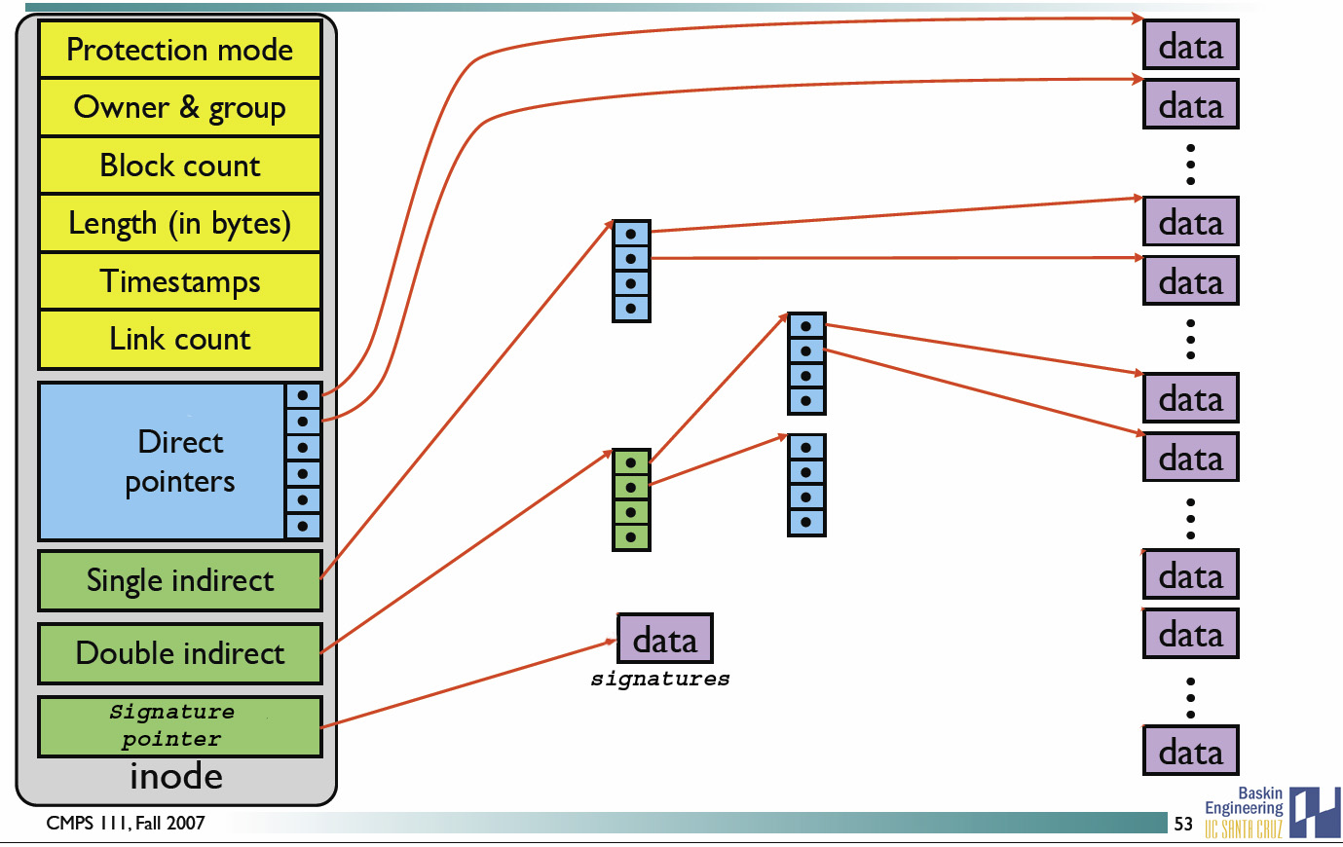
Inode Structure

Slide 25
Overview of File Subsystem (cont..)
Several file names may be associated with a single inode, but each file is controlled by exactly ONE inode.
ls –i (to get inode number)
$ ls -li /tmp/a /home/bob/xfile /var/tmp/file
114693 -rw-r-r- 3 hjc hjc 5 Sep 6 13:55 /tmp/a
114693 -rw-r-r- 3 hjc hjc 5 Sep 6 13:55 /home/bob/xfile
114693 -rw-r-r- 3 hjc hjc 5 Sep 6 13:55 /var/tmp/file
Inode no.
Permissions
Link count
Owner/group
size
Time Stamp

Slide 26
Finding a file’s Inode on Disk

Slide 27
Example
when a user issues open(``/etc/passwd'', ...) the kernel performs the following operations:
kernel finds the inode of the root directory and search the corresponding file for the entry ``etc''
when the entry ``etc'' is found, fetch its corresponding inode and check that it is of type directory
scan the file associated with ``/etc'' looking for ``passwd'‘
finally, fetch the inode associated with passwd's directory entry, verify that it is a regular file, and start accessing the file.

Slide 28
Data Structure for File Access
User File Descriptor Table
Inode Table
List of all I-nodes
Global File table
It is global to the kernel
It keeps track of the byte offset in the file where the user's next read/write will start .
It also keeps track of the access rights allowed to the opening process.
User/Process File Descriptor table
local to every process
contains information like the identifiers of the files opened by the process.
Whenever, a process creates / open a file, it gets an index from this table called as ”File Descriptor”.
File Table
Inode Table

Slide 29
Interaction between tables with an Example
Example:
Process A: fd1 = open("/var/file1", O_RDONLY); fd2 = open("/var/file2", O_RDWR); fd3 = open("/var/file1", O_WRONLY);
Process B: fd1 = open("/var/file1", O_RDONLY); fd2 = open("/var/file3", O_RDONLY);

Slide 30
File Descriptors, File Table and Inode table

Slide 31
Explanation of figure
Each open() returns a file descriptor to the process, and the corresponding entry in the user file descriptor table points to a unique entry in the global file table even though a file(/var/file1) is opened more then once.
These global file table entries map to the in-core inode table entry. Every opened file has a unique entry in the global file table and the user file descriptor table but kernel keeps only single entry per file in the in-core inode table.
Separate entries are created in user file descriptor and global file table, but only the reference count is increased in the inode table. All the system calls related to file handling use these tables for data manipulation.

Slide 32
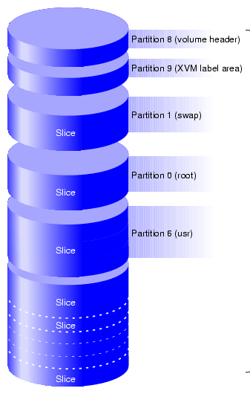
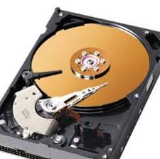
File System
Physical Drive
Files and Directories
Partitions

Slide 33
File System
A file system is consists of a sequence of logical blocks (512/1024 byte or multiple of 512 bytes )
disk drive
partition
partition
partition
file system
Data blocks for files, dirs, etc.
I-list
boot block
super block
i-node
i-node
i-node
. . . . . . . . .
i-node

Slide 34
File System
Using large logical blocks increases the effective data transfer rate between disk and memory, because the kernel can transfer more data per disk operation and therefore make fewer time-consuming operations.
E.g. reading 1k bytes from a disk in one read operation is faster than reading 512 bytes twice.

Slide 35
File System: Boot Block
Typically occupies the first sector of the disk
Holds bootstrap code i.e. read into the machine to boot, or a short program for (initialize) loading the kernel of OS and launching it

Slide 36
File System: Super Block
Contains information about the geometry of the physical disk
Describes the state of a file system - the size of the file system, how many files it can store, where to find free space on the file system, a chain of free data block numbers, a chain of free i-node numbers

Slide 37
File System: Inode List
Inodes are used to access disk files.
Inodes maps the disk files
For each file there is an inode entry in the inode list block
Inode list also keeps track of directory structure

Slide 38
File System: Data Block
Starts at the end of the inode list
Contains disk files (Data)
An allocated data block can belong to one and only one file in the file system

Slide 39
Contents
Architecture of Unix Operating System
Introduction to the System Concepts
An overview of the file subsystem
Processes
Context of a process
Process states
State transitions
Sleep and wakeup
Kernel Data Structure
System Administration

Slide 40
Processes
A process is the execution of a program
A process consists of :
object code (program or text) to be executed
data which the process works on
Stack
Required resources
Process P_{k}
Code
Data
Resource R₀
Resource R₁
Stack
Resource R_{N}
Abstract Machine Environment (OS)

Slide 41
Processes (Cont..)
Many process can run simultaneously as kernel schedules them for execution
Several processes may be instances of one program
A process reads and writes its data and stack sections, but it cannot read or write the data and stack of other processes
Processes communicate with other processes via system calls.
A process on a Unix system is the entity i.e. created by the fork system call.

Slide 42
Processes (Cont..)
Every process except process 0 is created when another process executes fork system call.
Every process has one parent process, but a process can have many child processes.
Process 0
fork
Process 1
fork
fork
Child Processes
fork

Slide 43
Processes (Cont..)
The kernel identifies each process by its process number, called the process ID (PID).
Very first process (process 0) which is created by the system boot code (system boots). After forking a child process (process 1) , process 0 becomes the swapper process.
Process 1, known as init process, is the ancestor of very other process in the system.

Slide 44
Process (Cont..)
Kernel loads an executable file into memory during ‘exec’ system call’
Loaded process consist of text, data, & stack.
Stack consist of logical stack frames
Stack Frame has
Local variables, address of previous frame, return address, parameters to function

Slide 45
Processes (Cont..)
#include <fcntl.h>
char buffer[2048];
int version ™ 1;
main(argc, argv)
int argc;
char *argv[];
{
int fdold, fdnew;
if (argc !=- 3)
{ printfC'need 2 arguments for copy program\n");
exit(l);
}
fdold =- open(argv[l], O_RDONLY);
/* open source file read only */
if (fdold 1)
{ printf ("cannot open file %s\n", argv[l]);
exit(l);
}
fdnew - creat(argv[2], 0666); /* create target file rw for all */
if (fdnew -- -1) { printf ("cannot create file %s\n", argv[2]); exit(1);}
copy(fdold, fdnew);
exit(l);
}
copy (old, new)
int old, new;
{
int count;
while ((count - readfold, buffer, sizeof(buffer))) > 0)
write (new, buffer, count);
}

Slide 46
Processes (Cont..)
user stack
kernel stack
Local
Vars
not
shown
Direction of
stack growth
Addr of Frame 2
Ret addr after write call
params to
write
new buffer
count
frame 3
call write()
frame 3
Local
Vars
count
Local
Vars
Addr of Frame 1
Addr of Frame 1
Ret addr after copy call
Ret addr after func2 call
params to
copy
old
new
parms to kernel func2
frame 2
call copy()
frame 2
call func2()
Local
Vars
fdold
fdnew
Local
Vars
Addr of Frame 0
Addr of Frame 0
Ret addr after main call
Ret addr after func1 call
params to
main
argc
argv
params to kernel func1
frame 1
call main()
frame 1
call func1()
frame 0 start
frame 0 system call interface

Slide 47
Processes (Cont..)
Kernel has a process table that keeps track of all active processes
Process table contains a per process region table whose entry points to entries in region table.

Slide 48
Data Structures for Process
per process
region table
region table
u area
process table
main memory

Slide 49
Process: Process Table
Fields of process table entry:
State field
User ID (UID)- owner of process
An event descriptor set when a process is suspended
u pointer (address)
User

Slide 50
Process: Region Table
A region is a contiguous area of a process’s address space such as
text, data and stack.
Region table entries describes the attributes of the region, such as
whether it contains text or data,
whether it is shared or private and
Where the “data” of region is located in memory

Slide 51
Process: U Area
U Area is the extension of process table entry
Fields of U Area
Pointer to process table entry of currently executing process
Parameters of the current system call, return values and error codes.
File descriptors of all open files
Current directory and current root
I/O parameters
Process and file size limit
Kernel can directly access fields of the U Area of the executing process but not of the U Area of other processes

Slide 52
Contents
Architecture of Unix Operating System
Introduction to the System Concepts
An overview of the file subsystem
Processes
Context of a process
Process states
State transitions
Sleep and wakeup
Kernel Data Structure
System Administration

Slide 53
Process Context
The context of a process is its state, which is defined by
Its text,
Values of global user variables, data structures, and machine registers
Values stored in Process table and U Area
Contents of user and kernel stack
When executing a process, the system is said to be executing in the context of the process.

Slide 54
Context Switch
When the kernel decides that it should execute another process, it does a context switch, so that the system executes in the context of the other process
When doing a context switch, the kernel saves enough information so that it can later switch back to the first process and resume its execution.

Slide 55
Mode of Process Execution
The UNIX process runs in two modes:
User mode
Can access its own instructions and data, but not kernel instruction and data
Kernel mode
Can access kernel and user instructions and data
requires special instruction sequence to change from user to kernel mode
When a process executes a system call, the execution mode of the process changes from user mode to kernel mode

Slide 56
Mode of Process Execution (cont..)
When moving from user to kernel mode, the kernel saves enough information so that it can later return to user mode and continue execution from where it left off.
Mode change is not a context switch, just change in mode.

Slide 57
Contents
Architecture of Unix Operating System
Introduction to the System Concepts
An overview of the file subsystem
Processes
Context of a process
Process states and State transitions
Sleep and wakeup
Kernel Data Structure
System Administration

Slide 58
Process States
Lifetime of process can be divided into a set of states.
Process states are:
User mode: currently executing
Kernel mode: currently executing
Ready to run : soon as the scheduler chooses it
Sleeping : waiting for I/O to complete.

Slide 59
Process State Transition
user
running
1
interrupt,
interrupt return
sys call
or interrupt
return
kernel
running
2
schedule
process
sleep
4
3
context switch
permissible
wakeup
ready to run

Slide 60
Process State Transition(cont..)
The kernel allows a context switch only when a process moves from the state kernel running to the state asleep
Process running in kernel mode cannot be preempted by other processes.
Kernel maintains consistency of its data structures because it is non-preemptive, uses mutual exclusion to restrict critical section.

Slide 61
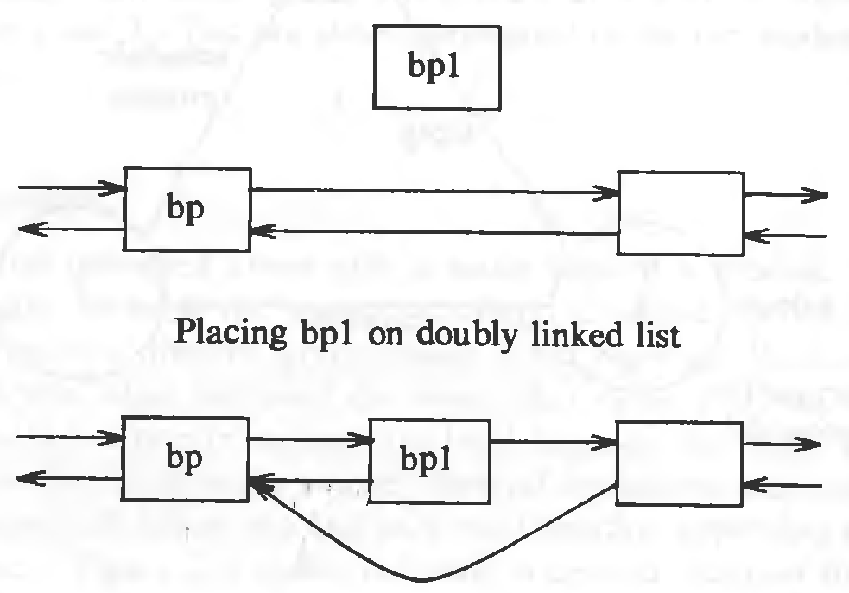
Example
struct queue {
} *bp, *bpl;
bpl—>forp — bp—>forp;
bpl—>backp — bp;
bp—>forp — bpl;
/* consider possible context switch here */
bp 1—>forp— >backp ~ bpl;
Unix prevents such situation by disallowing context switching when process is in kernel mode.

Slide 62
Contents
Architecture of Unix Operating System
Introduction to the System Concepts
An overview of the file subsystem
Processes
Context of a process
Process states and State transitions
Sleep and wakeup
Kernel Data Structure
System Administration

Slide 63
Sleep and wakeup
Process go to sleep when awaiting to happen some event such as
Waiting for I/O completion
Waiting for process to exit
Waiting for system resources to become available
And so on
When event occurs all sleeping process on that event get wake up and enter in “ready to run” state
Sleeping processes do not consume CPU resources

Slide 64
Sleep and wakeup (cont..)
Locks
used to lock some shared data structures and other resources.
Implementation of lock
while(condition is true)
sleep(event: condition becomes false);
set condition true;
When event occur unlock the lock and awakens all processes asleep on lock.
set condition false;
wakeup(event: condition is false);
Consider processes A, B and C contended for a locked buffer.

Slide 66
Kernel Data Structures
Fixed size tables
Advantage: Kernel code is simple
Disadvantage: Limits no. of entries in table
If table size exceeds kernel should report error to user.
Dynamic allocation
Excess table space is wasted
For simplicity of kernel algorithms Fixed size tables are used.

Slide 67
System Administration
Administrative Processes are used to perform various functions for general welfare of user community.
Disk formatting
Creation of new file systems
Repair of damaged file systems
Kernel debugging, etc…
Administrative processes are distinguished in terms of rights and privileges provided to them.
Eg. File access permissions allows manipulation to administrative process not to user process.
Superuser
has special privileges.
User may become superuser by using login-password.

Slide 68
Exercise
Assignment 1:
What should happen if the kernel attempts to awaken all processes sleeping on an event, but no process are asleep on the event at the time of the wakeup?
No process is waken up.
If scheduler finds at least one process in the queue, everything goes on.
If not, no process will be scheduled, and kernel will not have anything to do so it will not do anything. It will be idle.
Then how would the kernel know, if it is idle, that some process wants it to do something?
Well, the answer is, scheduler comes a checks the ready to run queue on every/some clock interrupts.

Slide 69
Exercise
Assignment 2:
Consider the following sequence of commands:
Case 1: grep main a.c b.c c.c > grepout &
wc —1 < grepout &
rm grepout &
The ampersand ("&") at the end of each command line informs the shell to run the command in the background, and it can execute each command line in parallel. Why is this not equivalent to the following command line?
Case 2: grep main a.c b.c c.c | wc —1

Slide 70
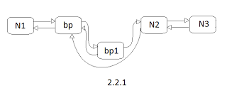
Excercise
Assignment 3:
struct queue { } *bp, *bpl;
bp1—>forp = bp—>forp;
bp1—>backp = bp;
bp—>forp = bp1;
/* consider possible context switch here, and scheduled process executes remove() function */
void remove(struct queue *qp)
{
qp—>forp —>backp = qp—>backp;
qp—>backp —>forp = qp—>forp;
qp—>forp = qp—>backp = NULL;
}
/*Return from context switch to execute remaining code*/
bp1—>forp— >backp = bp1;
So what is the status of the link list if
case 1: qp = bp;
case 2: qp = bp1;
case 3: qp = Node that follows bp in original Link List i.e. before adding bp1.

Slide 71
Any Question

