Slide 1
Unit -06
PLDs

Slide 2
Programmable Logic Device(PLDs)
• Till now we used MSI chips for designing
different logic ckts. Due to their fixed functions,
they are called as Fixed Function Ics.
• There are two more approaches to design digital
ckts.
1. ASICs (Application Specific Integrated Ckt)
2. PLDs (Programmable Logic Devices)

Slide 3
Types of PLDs
ROMs(Read only memories)
PLAs(Programmable Logic Arrays)
PALs(Programmable Array Logics)
CPLDs(Complex Programmable Logic Devices )
FPGAs(Field Programmable Gate Arrays)

Slide 4
PLAs(Programmable Logic Arrays) Block Diagram:
I0
S0
I0
Input Buffer
AND Matrix
S0
Invert/ Noninvert Matrix
FFs or O/P Buffer
I0’
P0
OR Matrix
S0’
F0
S1
I1
I1
P1
S1
F1
.
.
.
S1’
I1’
.
.
.
.
.
.
.
.
.
.
.
.
.
.
.
In-1
Sn-1
In-1
Pn-1
Sn-1
Sn-1’
Fm-1
In-1’

Slide 5
Programmable Logic Arrays (PLAs)
Pre-fabricated building block of many AND/OR gates
”Personalized" by making or breaking connections among gates
Both AND & OR arrays are programmable.
Programmable array block diagram for sum of products form
• • •
inputs
AND array
OR array
product terms
outputs
• • •

Slide 6
Design of Boolean functions using PLA
Example 1:
F0 = A + B' C'
F1 = A C' + A B
F2 = B' C' + A B
F3 = B' C + A
Shared product terms among outputs
AB, B’C, AC’, B’C’, A
PLA Program Table:
input side:
1 = uncomplemented in term
0 = complemented in term
– = does not participate
product inputs outputs
term A B C F0 F1 F2 F3 AB 1 1 – 0 1 1 0 B'C – 0 1 0 0 0 1 AC' 1 – 0 0 1 0 0 B'C' – 0 0 1 0 1 0 A 1 – – 1 0 0 1
output side:
1 = term connected to output
0 = no connection to output
reuse of terms

Slide 7
Design of Boolean functions using PLA
Example 2: F0 = A B + A' B'
F1 = C D' + C' D
A
B
C
D
A B
A B
C D
C D
F0
F1

Slide 8
PLA Design Example
Example 3: code converter
A B C D W X Y Z 0 0 0 0 0 0 0 0 0 0 0 1 0 0 0 1 0 0 1 0 0 0 1 1 0 0 1 1 0 0 1 0 0 1 0 0 0 1 1 0 0 1 0 1 1 1 1 0 0 1 1 0 1 0 1 0 0 1 1 1 1 0 1 1 1 0 0 0 1 0 0 1 1 0 0 1 1 0 0 0 1 0 1 – – – – – 1 1 – – – – – –
A
A
0 0 X 1
0 1 X 1 0 1 X X
0 1 X X
0 1 X 0
0 1 X 0 0 0 X X
0 0 X X
D
D
C
C
B
B
K-map for W
K-map for X
A
A
0 1 X 0
0 1 X 0 1 1 X X
1 1 X X
0 0 X 1
1 0 X 0 0 1 X X
1 0 X X
minimized functions:
W = A + B D + B C
X = B C'
Y = B + C
Z = A'B'C'D + B C D + A D' + B' C D'
D
D
C
C
B
B
K-map for Y
K-map for Z

Slide 9
PLA Design Example (cont’d)
Code converter: programmed PLA
A B C D
minimized functions:
W = A + B D + B C
X = B C'
Y = B + C
Z = A'B'C'D + B C D + A D' + B' C D'
x
x
A
BD
BC
BC'
B
C
A'B'C'D
BCD
AD'
BCD'
x
x
x
x
x
x
x
x
x
x
x
x
x
x
x
x
x
x
x
x
x
x
x
x
x
x
x
x
x
W X Y Z

Slide 10
PLA Design Example 4: Magnitude comparator
A B C D
A'B'C'D'
A'BC'D
ABCD
AB'CD'
AC'
A'C
B'D
BD'
A'B'D
B'CD
ABC
BC'D'
A
A
1 0 0 0
0 1 0 0 0 0 1 0
0 0 0 1
0 1 1 1
1 0 1 1 1 1 0 1
1 1 1 0
D
D
C
C
B
B
K-map for EQ
K-map for NE
A
A
0 0 0 0
1 0 0 0 1 1 0 1
1 1 0 0
0 1 1 1
0 0 1 1 0 0 0 0
0 0 1 0
D
D
C
C
B
B
K-map for LT
K-map for GT
EQ NE LT GT

Slide 11
Design of Boolean functions using PLA
Example 5:
A
B
C
Multiple functions of A, B, C
ABC
A
F1 = A B C
F2 = A + B + C
F3 = A B C
F4 = A + B + C
F5 = A xor B xor C
F6 = A xnor B xnor C
B
C
A
B
C
ABC
ABC
ABC
ABC
ABC
ABC
ABC
F1
F2
F3
F4
F5
F6

Slide 12
PALs(Programmable Array Logics)
Only AND array is Programmable
OR array is fixed.
Not as flexible as PLA.

Slide 13
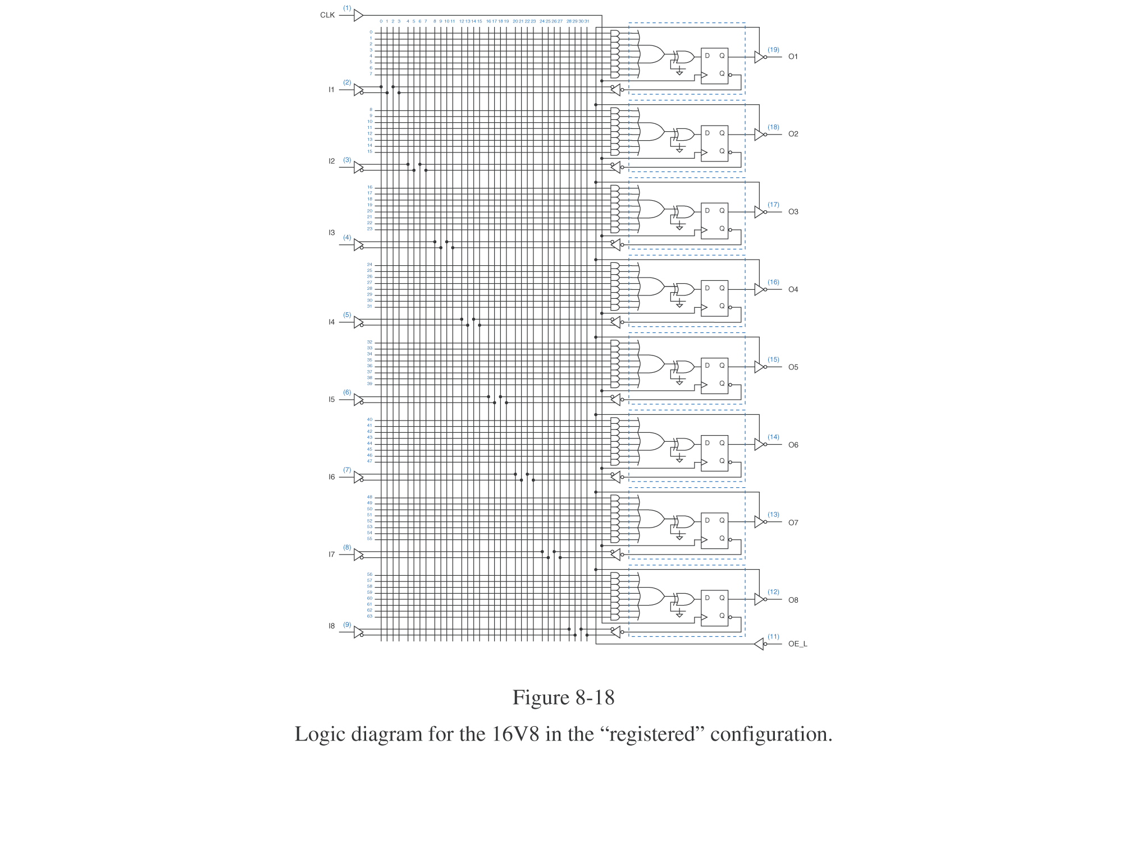
PLD with F/Fs(Registered PAL)

Slide 14
ROM Structure
Similar to a PLA structure but with a fully decoded AND array
Completely flexible OR array (unlike PAL)
n address lines
• • •
inputs
memory array (2^{n} words by m bits)
decoder
2^{n} word lines
outputs
• • •
m data lines

