Slide 1
Unit-I 80386DX Architecture
History of 8086 microprocessor, Concept of segmentation in 8086, 8086 Register block diagram
80386DX functional Block Diagram, PIN Description, Register set, Flags, Physical address space, Data types

Slide 2
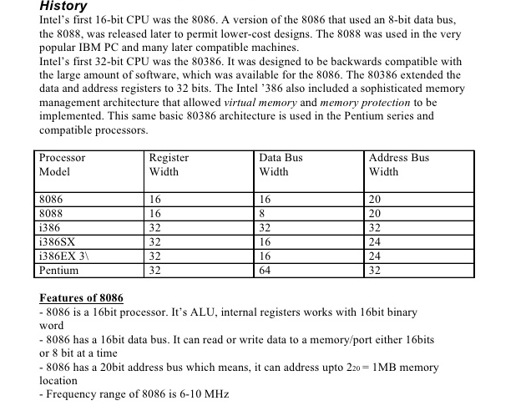
History of 8086

Slide 3
Architecture of 8086
The architecture of 8086 includes
Arithmetic Logic Unit (ALU)
Flags
General registers
Instruction byte queue
Segment registers

Slide 4
EU & BIU
The 8086 CPU logic has been partitioned into two functional units namely Bus Interface Unit (BIU) and Execution Unit (EU)
The major reason for this separation is to increase the processing speed of the processor
The BIU has to interact with memory and input and output devices in fetching the instructions and data required by the EU
EU is responsible for executing the instructions of the programs and to carry out the required processing

Slide 5
Architecture Diagram

Slide 6
Execution Unit
The Execution Unit (EU) has
Control unit
Instruction decoder
Arithmetic and Logical Unit (ALU)
General registers
Flag register
Pointers
Index registers

Slide 7
Execution Unit
Control unit is responsible for the co-ordination of all other units of the processor.
ALU performs various arithmetic and logical operations over the data.
The instruction decoder translates the instructions fetched from the memory into a series of actions that are carried out by the EU.

Slide 8
Execution Unit - Registers
General registers are used for temporary storage and manipulation of data and instructions
Accumulator register consists of two 8-bit registers AL and AH, which can be combined together and used as a 16-bit register AX
Accumulator can be used for I/O operations and string manipulation

Slide 9
Execution Unit - Registers
Base register consists of two 8-bit registers BL and BH, which can be combined together and used as a 16-bit register BX .
BX register usually contains a data pointer used for based, based indexed or register indirect addressing.
Count register consists of two 8-bit registers CL and CH, which can be combined together and used as a 16-bit register CX .
Count register can be used as a counter in string manipulation and shift/rotate instructions.

Slide 10
Execution Unit - Registers
Data register consists of two 8-bit registers DL and DH, which can be combined together and used as a 16-bit register DX.
Data register can be used as a port number in I/O operations.
In integer 32-bit multiply and divide instruction the DX register contains high-order word of the initial or resulting number .

Slide 11
Execution Unit - Registers

Slide 12
Execution Unit - Flags

Slide 13
Execution Unit - Flags

Slide 14
Flags
Conditional Flags:
Set or reset by EU on the basis of the results of arithmetic or logic operation
Control Flags (TF,IF,DF)

Slide 15
Execution Unit - Pointers
Stack Pointer (SP) is a 16-bit register pointing to program stack
Base Pointer (BP) is a 16-bit register pointing to data in stack segment. BP register is usually used for based, based indexed or register indirect addressing.
Source Index (SI) is a 16-bit register. SI is used for indexed, based indexed and register indirect addressing, as well as a source data addresses in string manipulation instructions.
Destination Index (DI) is a 16-bit register. DI is used for indexed, based indexed and register indirect addressing, as well as a destination data addresses in string manipulation instructions.

Slide 16
Bus Interface Unit
The BIU has
Instruction stream byte queue
A set of segment registers
Instruction pointer

Slide 17
BIU – Instruction Byte Queue
8086 instructions vary from 1 to 6 bytes
Therefore fetch and execution are taking place concurrently in order to improve the performance of the microprocessor
The BIU feeds the instruction stream to the execution unit through a 6 byte prefetch queue
This prefetch queue can be considered as a form of loosely coupled pipelining

Slide 18
Segment Registers
The memory of 8086 is divided into 4 segments namely
Code segment (program memory)
Data segment (data memory)
Stack memory (stack segment)
Extra memory (extra segment)

Slide 19
Different Areas in Memory
Program memory – Program can be located anywhere in memory
Data memory – The processor can access data in any one out of 4 available segments
Stack memory – A stack is a section of the memory set aside to store addresses and data while a subprogram executes
Extra segment – This segment is also similar to data memory where additional data may be stored and maintained

Slide 20
Segment Registers
Code Segment (CS) register is a 16-bit register containing address of 64 KB segment with processor instructions.
The processor uses CS segment for all accesses to instructions referenced by instruction pointer (IP) register.
Stack Segment (SS) register is a 16-bit register containing address of 64KB segment with program stack.
By default, the processor assumes that all data referenced by the stack pointer (SP) and base pointer (BP) registers is located in the stack segment

Slide 21
Segment Registers
Data Segment (DS) register is a 16-bit register containing address of 64KB segment with program data.
By default, the processor assumes that all data referenced by general registers (AX, BX, CX, DX) and index register (SI, DI) is located in the data segment .
Extra Segment (ES) register is a 16-bit register containing address of 64KB segment, usually with program data.
By default, the processor assumes that the DI register references the ES segment in string manipulation instructions

Slide 22
Segment Registers

Slide 23
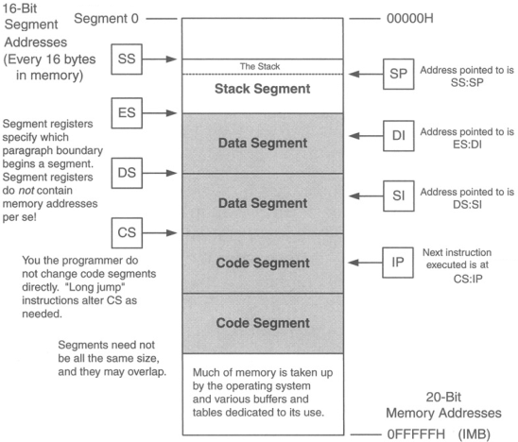
Memory Segmentation

Slide 24
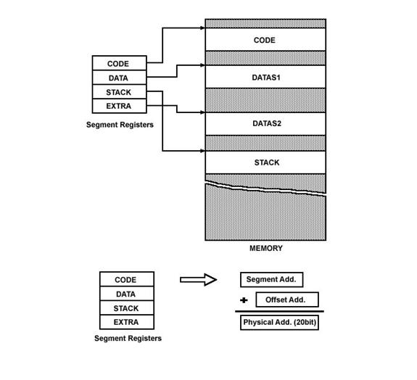

Slide 25
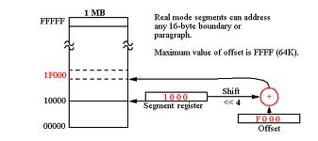
20-bit Physical address generation

Slide 26
Thank You!

